Slide 2
Changing Our Attitude about Those Who’ve Never Heard
A Special Sunday Message
Selected Scriptures
© October 1, 2017
Wade Harlan
Notes:
2

Slide 3
Do All Roads Lead to Heaven?
Islam
5 pillars
Jesus only appeared to die on the cross
Mohammed, not Jesus was the final prophet
can’t have assurance of salvation
Hinduism
this life determined by past life, reincarnation, karma,
Brahman (being of ultimate oneness) but millions of gods
dedication to a deity or to ceremonies, meditation to end cycle of karma
Judaism
Jesus was not the Messiah who would save them.
The Messiah is yet to come.

Slide 4
Do All Roads Lead to Heaven?
Buddhism
there is no God.
Siddhartha Gautama merely the model of how to attain spiritual enlightenment
”to blow out the candle of desire” and attain nirvana – a state of total nothingness.
One’s greatest desire is to rid oneself of all desire.
Animism
THE world religion
appease evil spirits
Christianity
Different from all other religions. Not do, but DONE
Notes:
Or as the Lion said “There is no other stream”

Slide 5
”God will allow all into heaven who have sincerely believed.”
Baal worshippers – would burn their children in the fire.
Hitler and his religion/worldview.
What if you sincerely believe you can survive jumping out the 52nd floor of your building?
Clearly, people can be sincerely wrong.

Slide 6
The Bible clearly teaches that Jesus is the only way to God
Salvation is found in no one else, for there is no other name under heaven given to men, by which we must be saved. (Acts 4:12).
For God so loved the world that he gave his one and only Son, that whoever believes in him shall not perish but have eternal life. For God did not send his Son into the world to condemn the world, but to save the world through him. Whoever believes in him is not condemned, but whoever does not believe stands condemned already because he has not believed in the name of God's one and only Son... "Whoever believes in the Son has eternal life, but whoever rejects the Son will not see life, for God's wrath remains on him (Jn 3:16-18, 36).

Slide 7
The Bible clearly teaches that Jesus is the only way to God
Everyone who calls on the name of the Lord will be saved." How, then, can they call on the one they have not believed in? And how can they believe in the one of whom they have not heard? And how can they hear without someone preaching to them? And how can they preach unless they are sent? As it is written, "How beautiful are the feet of those who bring good news! Romans 10:13-15
⁶ Jesus answered, “I am the way and the truth and the life. No one comes to the Father except through me.” John 14:6

Slide 8
What About Those Who Have Never Heard?
For God so loved the world that he gave his one and only Son, that whoever believes in him shall not perish but have eternal life. For God did not send his Son into the world to condemn the world, but to save the world through him. Whoever believes in him is not condemned, but whoever does not believe stands condemned already because he has not believed in the name of God's one and only Son. John 3:16-18
Because of sin, all stand condemned before God.

Slide 9
What About Those Who Have Never Heard?
Because of sin, all stand condemned before God.
Everyone is without excuse for not knowing God exists. (Romans 1)

Slide 10
¹⁸ The wrath of God is being revealed from heaven against all the godlessness and wickedness of people, who suppress the truth by their wickedness, ¹⁹ since what may be known about God is plain to them, because God has made it plain to them. ²⁰ For since the creation of the world God’s invisible qualities—his eternal power and divine nature—have been clearly seen, being understood from what has been made, so that people are without excuse. ²¹ For although they knew God, they neither glorified him as God nor gave thanks to him, but their thinking became futile and their foolish hearts were darkened. ²² Although they claimed to be wise, they became fools ²³ and exchanged the glory of the immortal God for images made to look like a mortal human being and birds and animals and reptiles.²⁴ Therefore God gave them over in the sinful desires of their hearts to sexual impurity for the degrading of their bodies with one another. ²⁵ They exchanged the truth about God for a lie, and worshiped and served created things rather than the Creator—who is forever praised. Amen. Romans 1:18-25

Slide 11
What About Those Who Have Never Heard?
What is the unpardonable sin?
The punishment must fit the crime.
Stealing a piece of bubble gum vs. stealing all the money in a bank?
The most heinous sin ever is to ignore and reject God’s love and sacrifice for us. Those that do it must spend eternity separated from God.
Because of sin, all stand condemned before God.
Everyone is without excuse for not knowing God exists. (Romans 1)
Rejecting God’s love and salvation is the most heinous crime ever.
Notes:
Which is a worse crime – to murder you best friend or to reject God’s offer of eternal life which he provided at the cost of his son. And the fact that he created you, gave you life so that you could enjoy an eternal relationship with Him.

Slide 12
What About Those Who Have Never Heard?
What will judgement be based upon?
That servant who knows his master's will and does not get ready or does not do what his master wants will be beaten with many blows. But the one who does not know and does things deserving punishment will be beaten with few blows. From everyone who has been given much, much will be demanded; and from the one who has been entrusted with much, much more will be asked.
(Luke 12:47-48)
On the Judgment Day there apparently will be differing levels of punishment based on what people know of God’s will.
Notes:
Not all have the same measure of condemnation, for not all have sinned against equal amounts of light. God does not condemn a person who has not heard of Christ for rejecting Him, but rather for rejecting the light he has.

Slide 13
What About Those Who Have Never Heard?
The disciples came to him and asked, "Why do you speak to the people in parables?" He replied, "The knowledge of the secrets of the kingdom of heaven has been given to you, but not to them. Whoever has will be given more, and he will have an abundance. Whoever does not have, even what he has will be taken from him. This is why I speak…in parables:.. Though seeing, they do not see; though hearing, they do not hear or understand" (Matthew 13:10-13). (cf Mark 4:21-25)
The pattern we see in scripture is that those that seek the truth are given more.
Ex. Cornelius, the Ethiopian Eunuch, the “devout men” at Pentecost …

Slide 14
What About Those Who Have Never Heard?
¹⁴ How, then, can they call on the one they have not believed in? And how can they believe in the one of whom they have not heard? And how can they hear without someone preaching to them? ¹⁵ And how can anyone preach unless they are sent? As it is written: “How beautiful are the feet of those who bring good news!” Romans 10:14,15
God’s method for dispensing the Good News is a human messenger.
Notes:
–the solution to the terrible lost condition of men is the preacher who is sent, the "beautiful feet" of him who goes. Ultimately, the problem is not with God's righteousness, but with ours.

Slide 15
What About Those Who Have Never Heard?
Does God have an alternative method?
Purgatory?
If there is an alternative, God has not told us of it.
Ex. Security Guard on the 10th floor of an office
shepherd on an island
What about dreams to those in the Muslim world?
Notes:
floor plan posted in a prominent place - clearly marked. What’s his responsibility? To even discuss with the patients or with a colleague the possibility of some other unmarked fire escape or recalls to them the news report he read of someone who had jumped from the tenth floor of a building and lived?
could surely be charged with criminal negligence.
He must live and labor in obedience to the facts that are certain and not delay to act. He must not lead people astray on the basis of conjecture based on limited information.

Slide 16
What About Those Who Have Never Heard?
"Will not the Judge of all the earth do right?" (Gen. 18:25).
⁹ Whoever is wise, let him understand these things; whoever is discerning, let him know them; for the ways of the Lord are right, and the upright walk in them, but transgressors stumble in them. Hosea 14:9
⁹ For as the heavens are higher than the earth, so are my ways higher than your ways and my thoughts than your thoughts. higher than your ways and my thoughts than your thoughts. Isaiah 55:9
Notes:
Abraham was pleading with God for the salvation of innocent people who did not deserve to be condemned and destroyed along with the guilty. He was appealing to God's justice, and God responded with grace more than Abraham dared ask. This crucial question recorded in the first book of the Bible is answered in the last:
If we understood all of God’s ways, he’d be such a small God.

Slide 17
What About Those Who Have Never Heard?
The argument of: “The way life is.
Families of divorce and alcoholism, unbelief
vs
Families with no history of divorce, alcoholism and all are believers.
Our actions do have a powerful influence on our children and their children, but those with generations of sin can still break out of it.

Slide 18
What About Those Who Have Never Heard?
“Everyone is already saved, I’m merely announcing to them the salvation they already have.”
Notes:
Missionary from the South believe me, if I thought these people were already saved, I would not be here.”

Slide 19
The Issue of Fairness
Is it fair that any person hear the gospel a second time, while there still remain those who’ve never heard it for the first time?
Notes:
- If it takes 29 touches ... It’s not fair for either of these people and we all need to get busy.

Slide 20
What About Those Who Have Never Heard?
When all has been said that can be said on this issue, the greatest remaining mystery is not the character of God nor the destiny of lost people. The greatest mystery is why those who are charged with rescuing the lost have spent 2 thousand years doing other things, good things, perhaps, but have failed to send and be sent until all have heard the liberating word of life in Christ Jesus.
The lost condition of human beings breaks the Father's heart.
What does it do to ours?

Slide 21
Pointing Our Finger at God
We shouldn’t say “Oh God you are so unfair in sending those that have never heard of you to hell.”
Instead our response should be “Lord, you are holy and we’re not. You created us to be in relationship with you but our sins and our rebellion against your ways have separated us from you and have kept us from recognizing you and your power in creation.
Thank you that you give more light to those that respond to you and seek you.
Most of all thank you that you sent Jesus to die for our sins to reconcile us back to You.
Oh God you have been so good and kind toward us, but we’ve failed to spread word of you like You asked us to. Please forgive us and help us Lord!

Slide 22
Summary
Through creation all should know that there is an all-powerful God. So everyone is without excuse.
Because of our sin, we all stand condemned, separated from God. The punishment fits the crime.
All religions are clearly not the same. Christianity is different from all other religions and Jesus clearly stated that He was the only way to know God.
God is not willing that any should perish, desires all to be saved, and provided a way for all to be saved.
Eternal punishment will be based upon how much each person knows.
The biblical pattern is when people respond to revelation, God sends more.
God has chosen people as his messengers/delivery method of salvation.
The Bible clearly proclaims that all of God’s ways are just and right.
We point our finger at God and say he is unfair, but we should point our finger at ourselves for being so stingy in sharing the gospel.

Slide 23
Possible Applications
Confess and repent for not being a more faithful ambassador for Christ.
Ask God to make you a “Fisher of Men & Women”
Pray for your neighbors using BlessEveryHome.com
Pray using Joshua Project’s Unreached People Group of the day
Pray for one UPG worker and their people group each day and continue even once the workers return.
Find and get active your role in World Evangelization (welcomer, pray-er, relational supporter, financial supporter, mobilizer, goer)

Slide 24
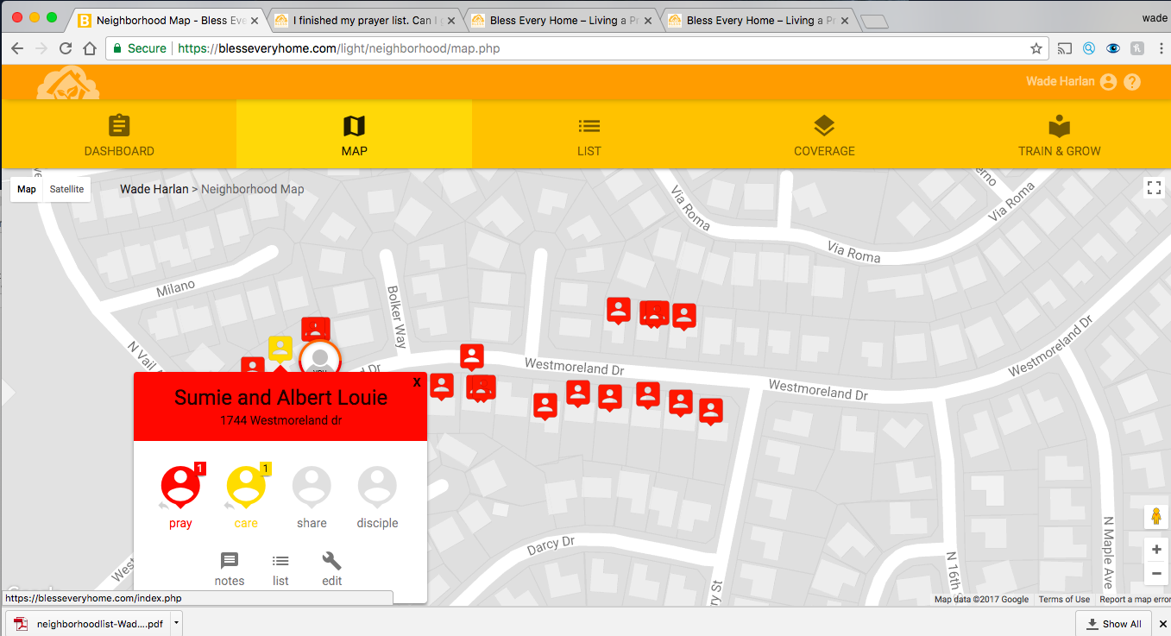

Slide 25
THREE PRACTICAL QUESTIONS FOR OUR EVERYDAY LIFE
What do you feel God is wanting you to do differently as a result of today’s message?
In this topic of those who have never heard have you been guilty of minimizing your own responsibility and blaming God?
How do you wrongfully ‘cope’ with the fact that you aren’t doing a very good job as God’s messenger to unbelievers?

Slide 27
HOMEGROUP GATHERINGS: TONIGHT [10/1]!
* Irvine: @5pm
* Santa Ana: @5pm
* Whittier: @4pm
Please BE ON TIME!
Join three homegroups—in Irvine, Santa Ana, & Whittier—at their Fall Kickoff gatherings.
HG gatherings are always OPEN to ALL!
For directions, call Takashi [Irvine] at 949.220.4589, Tuong [Santa Ana] at 949.677.8153 or Stan [Whittier] at 714.872.0726.
Notes:
27

Slide 28
A PARENTING SEMINAR WITH DR. PAUL DAVID TRIPP
Saturday, October 21, 2017 9am to 3pm @ CW Facility Lunch & Childcare Provided!
All video sessions are taught by an award-winning author, Dr. Paul Tripp on “Parenting: Gospel Principles That Can Radically Change Your Family”.
This 6-hour seminar has 4 Sessions and breaks for discussion and lunch.
Cost: Only $20/person or $30/couple
INVITE your friends and RSVP to Jamie Park TODAY!!!
Mark your calendars or Cancel your plans! Nothing’s more worthwhile to invest time and money towards!

Slide 29
UPCOMING LOCAL OUTREACH EVENT
Join us at an upcoming local outreach event:
Sheepfold in Orange (October 7th, Sat. 7-8pm) Sheepfold is a ministry that “provides hope and refuge for mothers with children in Jesus' name.”
Contact Tuong Bui at 949.677.8153 for more information.
Notes:
29

Slide 30
THAILAND MEDICAL MISSIONS TEAM REPORT NIGHT
Saturday Night [10/28] 7pm at CW Sanctuary
Mark your calendar now!
This is a great opportunity to hear what God has done in through Thailand Medical Missions Team.
Hear the stories and testimonies of the team members Missions in a more intimate interactive setting.
For more information, contact Christine at 714.865.9404.
Notes:
30

Slide 31
COMING SOON: All-Church Fall Picnic!!!
October 29th, Sunday
Immediately after the Service
At a nearby park: Santiago Hills Park
A Pot-luck picnic lunch, BBQ, Games & FUN.
Come PREPARED—bring a T-shirt & shorts, sneakers, picnic blankets, and lawn chairs, etc.
Have your kids (and yourself) wear a favorite costume—as an alternative celebration to Halloween!
Come, eat, laugh, play and hang out together!!!
There will be no homegroup on this picnic day.
Notes:
31

