Slide 2
To the Ends of the Earth
Missions Month Week #4 Message
Matthew 28:18-20
© March 25, 2018
John J. Lee
Notes:
2

Slide 3
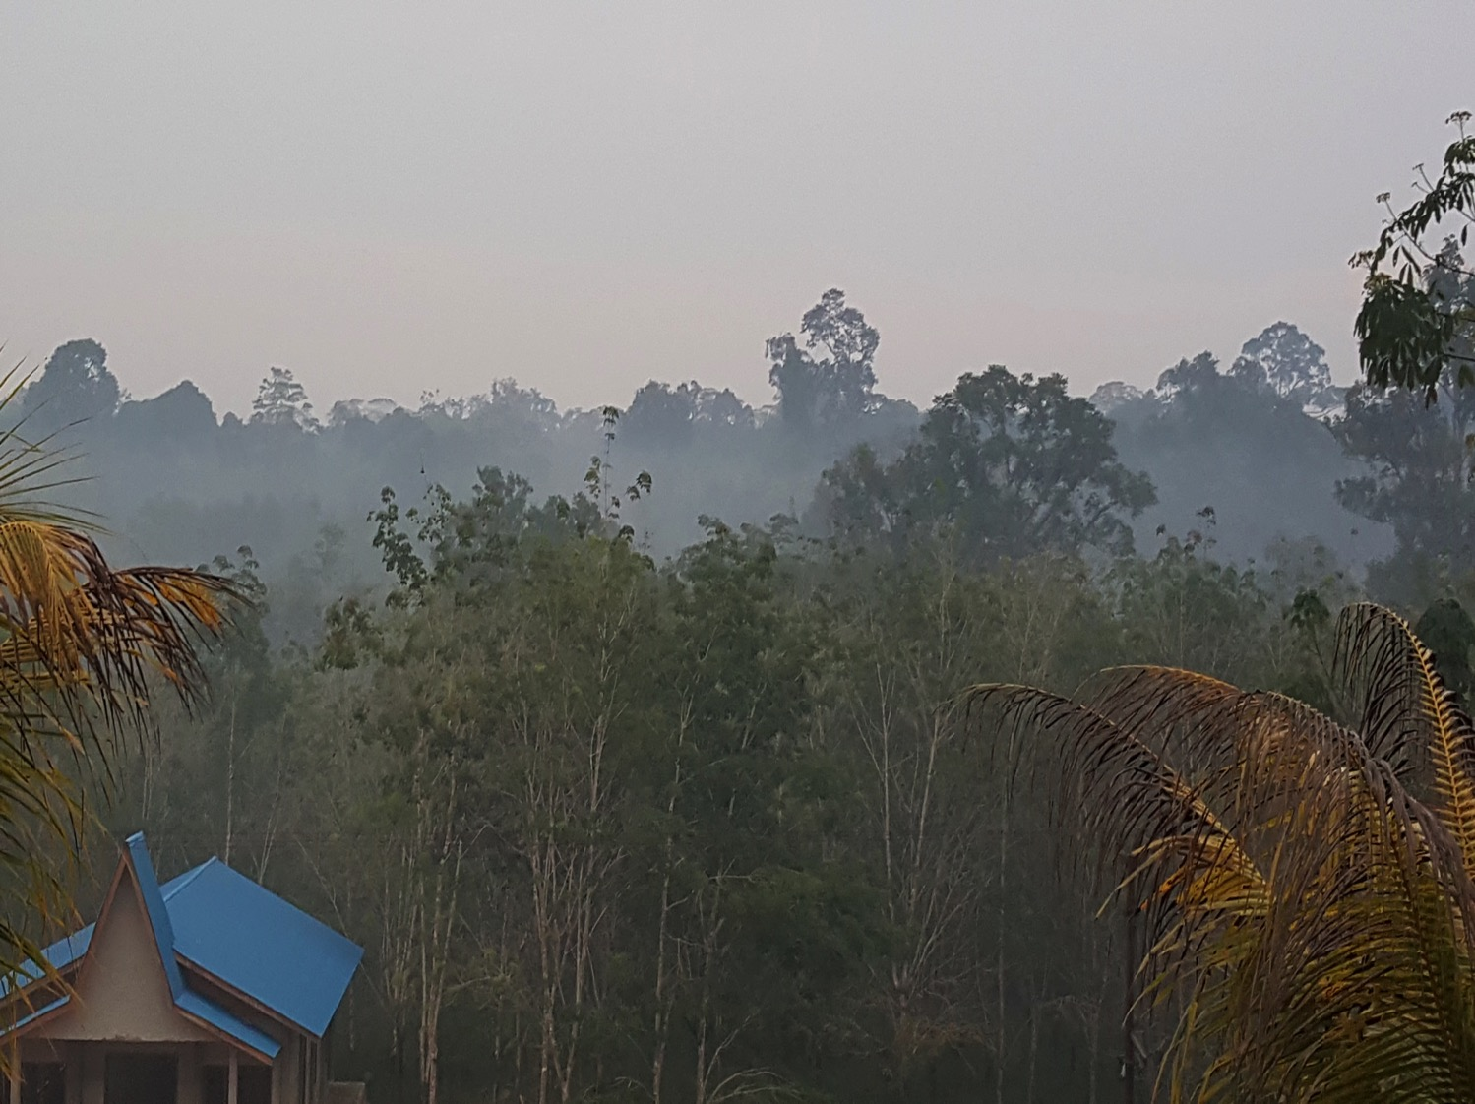
To the Ends of the Earth…
Matthew 28: 18-20

Slide 4
Make Disciples of All Nations...
(Matthew 28:18-20)

Slide 5
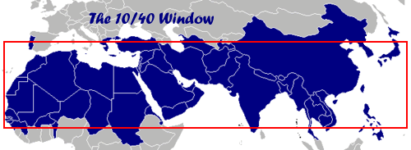
Knowing God’s Heart:
Status of the Great Commission
10 degrees north and 40 degrees north latitude.
65% of the world population; 95% of the unreached peoples, and 90% of the world’s poor live here.
It is also home to majority of the world’s Muslims, Hindus, and Buddhists.

Slide 6
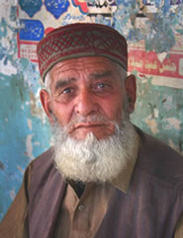
Countries with the Most Unreached Peoples*
Country | # Peoples Total | # Unreached Peoples / (%)
India | 2533 | 2222 / 88%
Pakistan | 463 | 448 / 97%
China | 516 | 427 / 83%
Bangladesh | 423 | 372 / 88%
Nepal | 380 | 355 / 93%
Indonesia | 784 | 200 / 26%
* Source, Operation World 2017

Slide 7
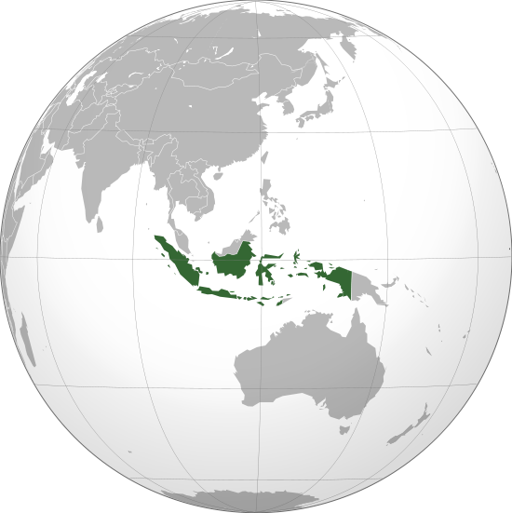
Indonesia
Population: 250,000,000
# Islands: 17,000
Religion: 88% Islam
7% Christian
(marginally)

Slide 8
Holistic Framework
Christ
Spiritual
Education
Social/ Health
Leader-ship

Slide 9
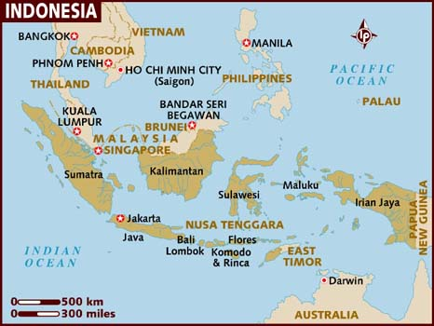

Slide 10
Bumi Indah Orphanage

Slide 11
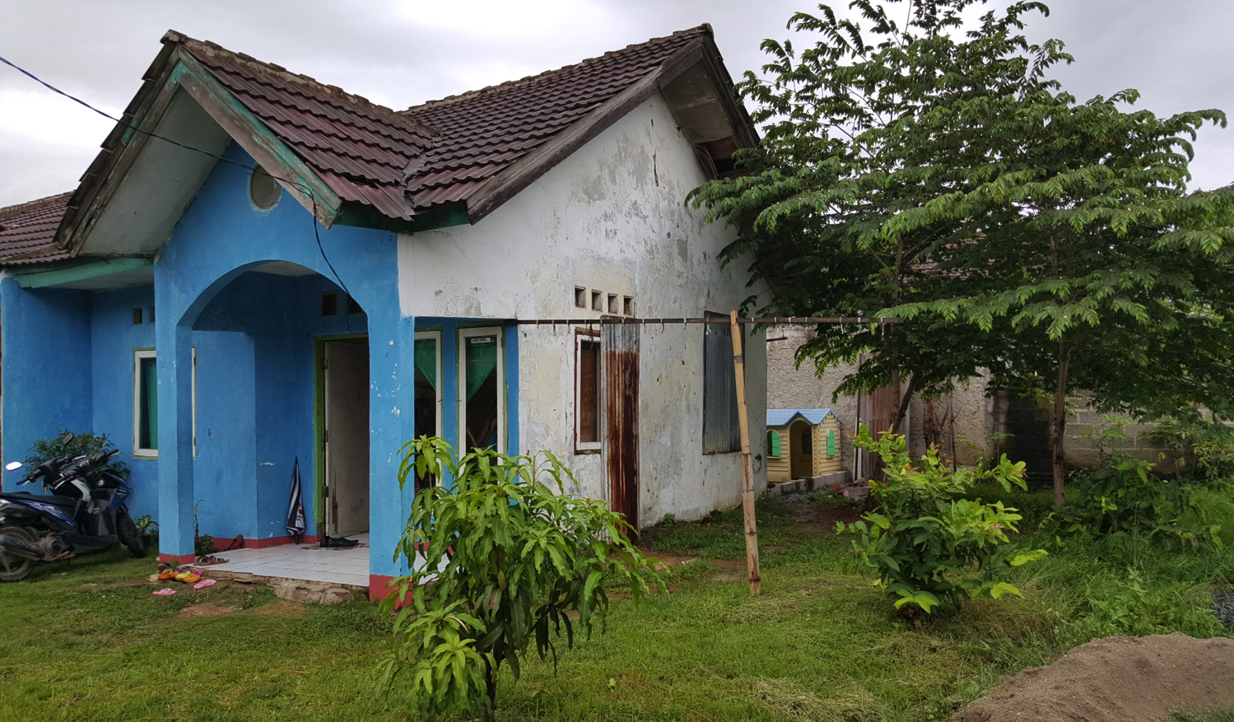
Old Building - Crumbling

Slide 13
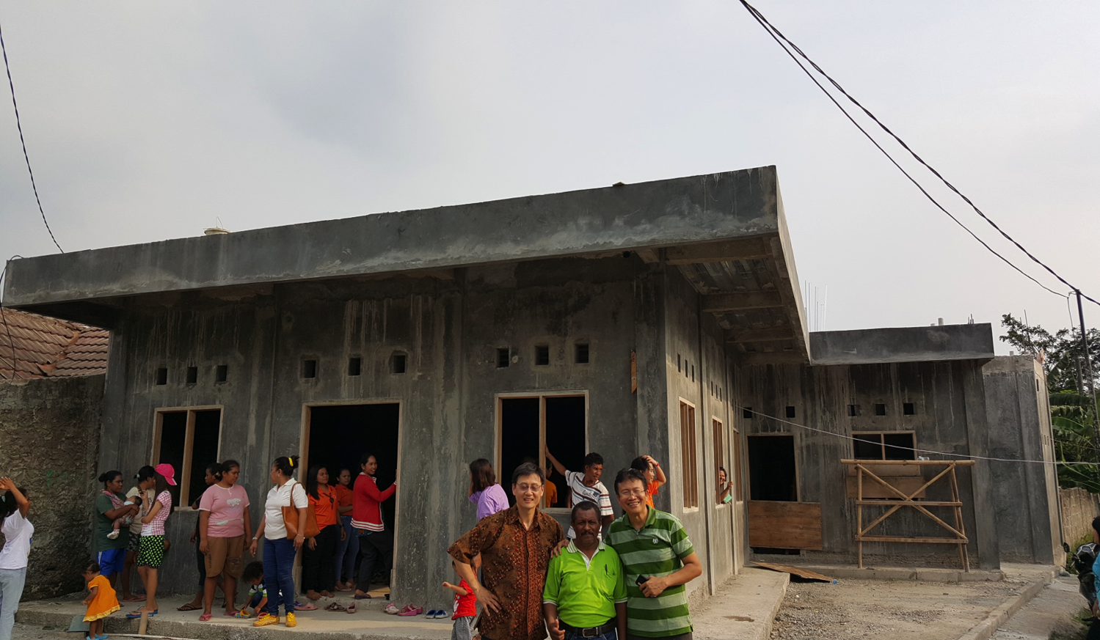
New Orphanage Under Construction

Slide 14
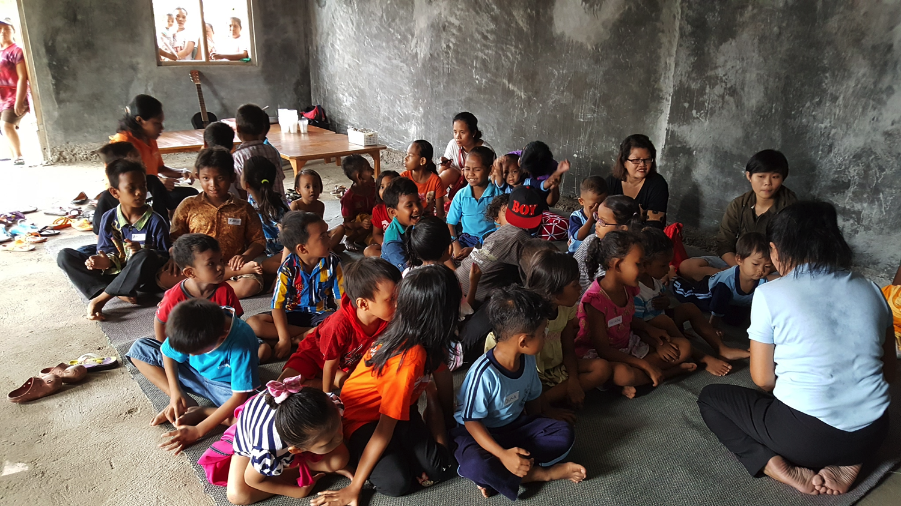
Orphanage Activities

Slide 15
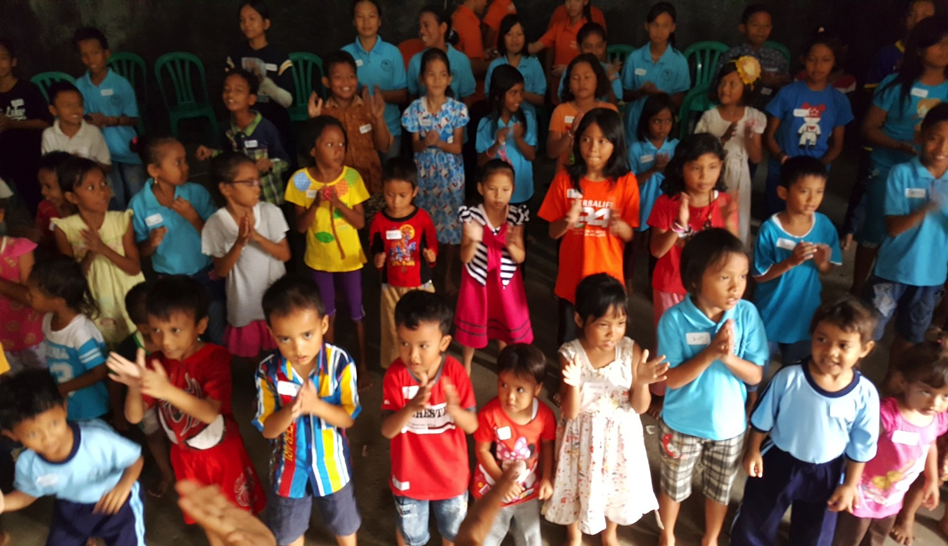
Bumi Indah

Slide 16
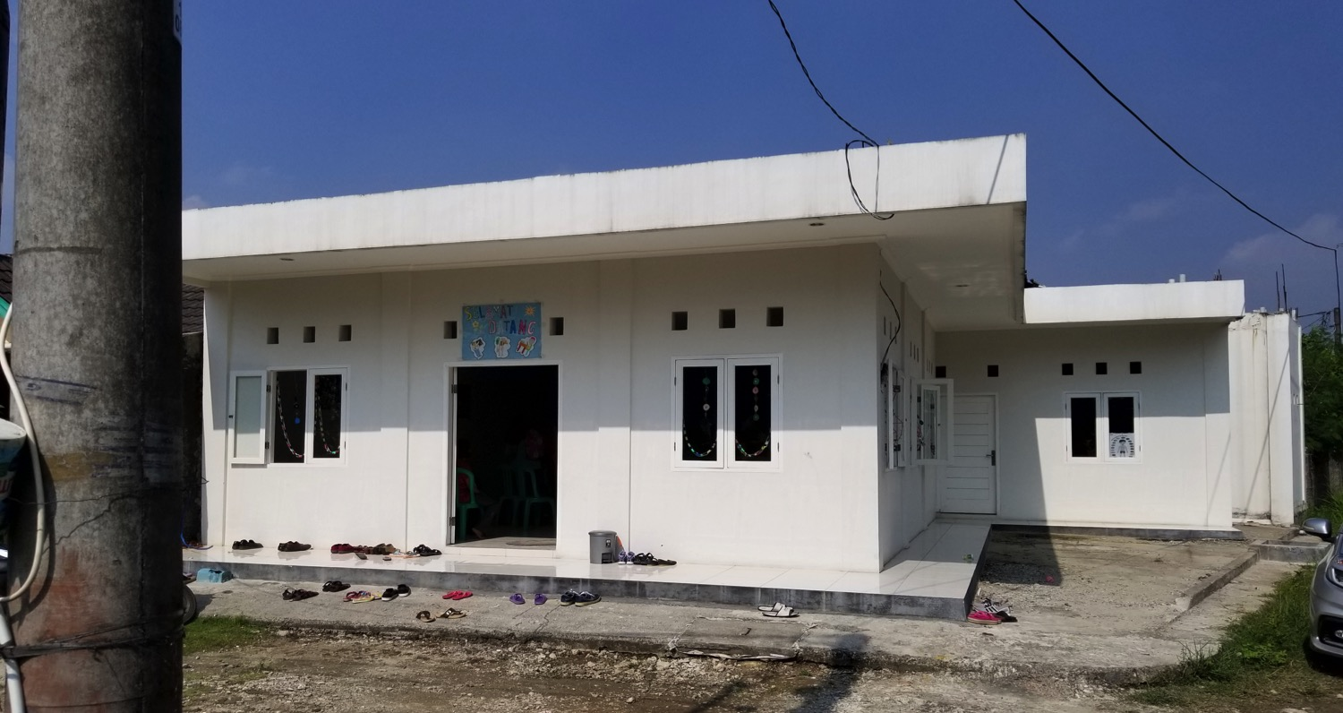
Bumi Indah Orphanage Building
(under Construction)

Slide 17
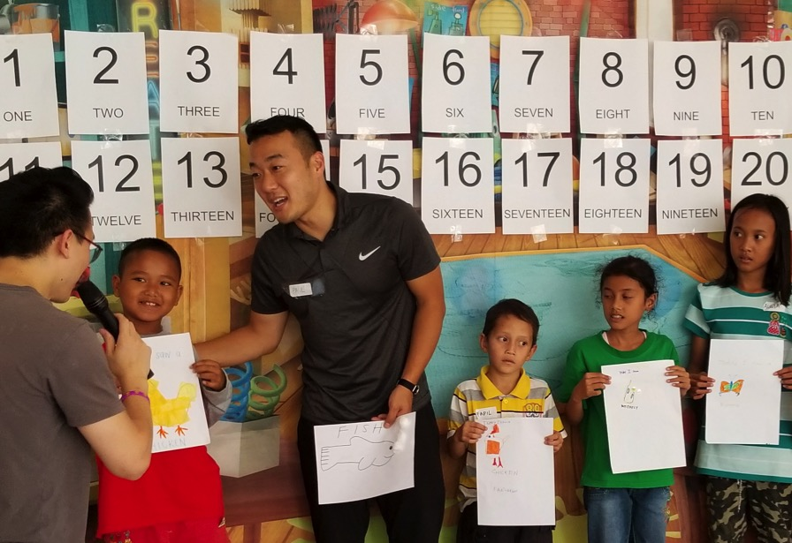
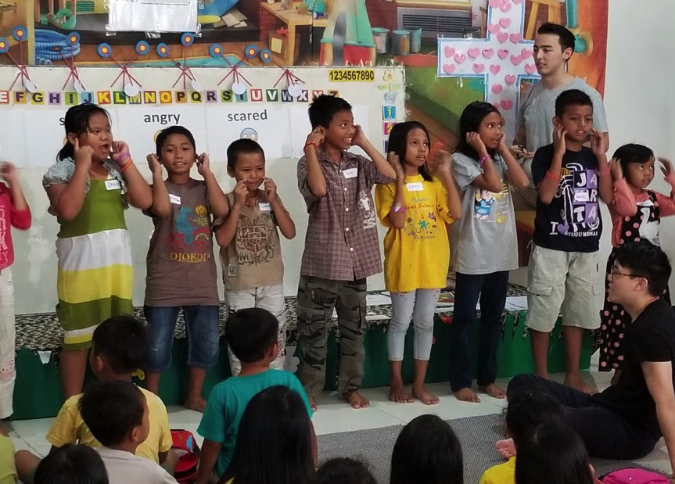
Summer English Camp Outreach

Slide 18
Make Disciples of All Nations...
(Matthew 28:18-20)
Papua:
A Remarkable Journey

Slide 19
Unreached/Least Reached People Group
Less than or equal to 2% Evangelical Christian and less than or equal to 5% Professing Christians.
An unreached or least-reached people is a people group among which there is no indigenous community of believing Christians with adequate numbers and resources to evangelize this people group without outside assistance.
Joshua Project

Slide 20
Make Disciples of All Nations: Papua
Notes:
자바 섬에서 복음의 불꽂이 술라웨시로 튀어…

Slide 21
6-month internship
From Jakarta to Jayapura, Papua
8 hours by plane + 1.5 hours by helicopter
To Reach Danowage jungle village
To serve the Korowai people (UPG)

Slide 22
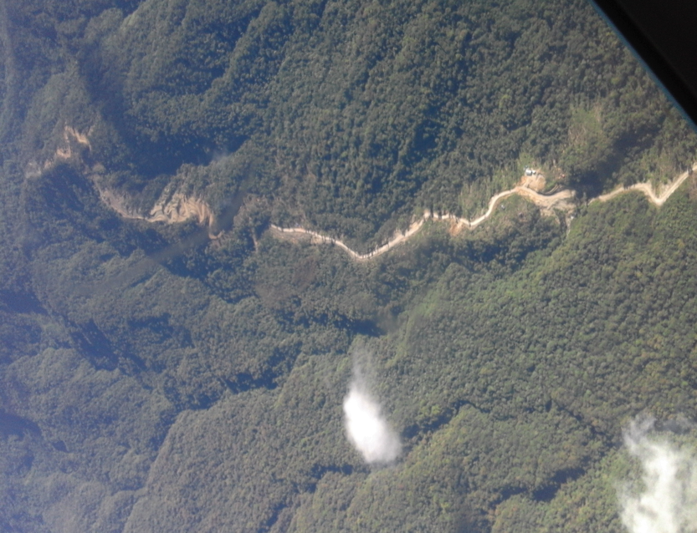
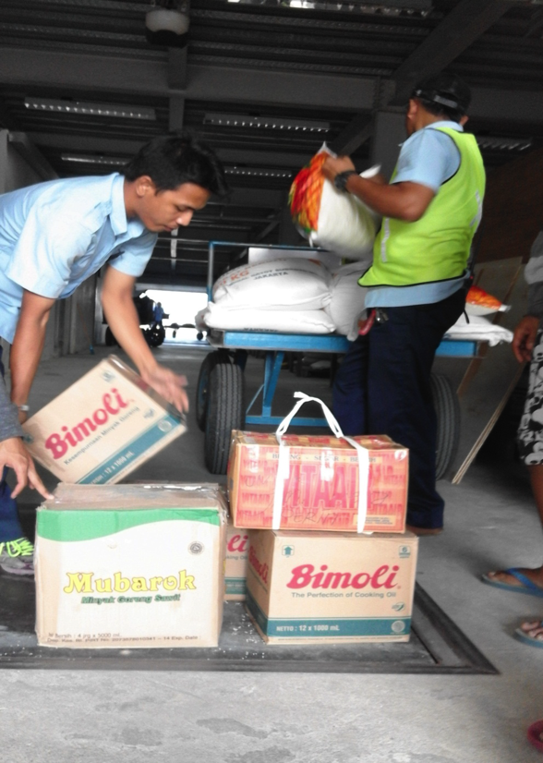
1.5 Hours by Helicopter:
They risked their lives to go and live among the most unreached peoples.
From Jayapura to Danowage:
800kg for 6 months of ministry. No stores to buy in the jungle.

Slide 23
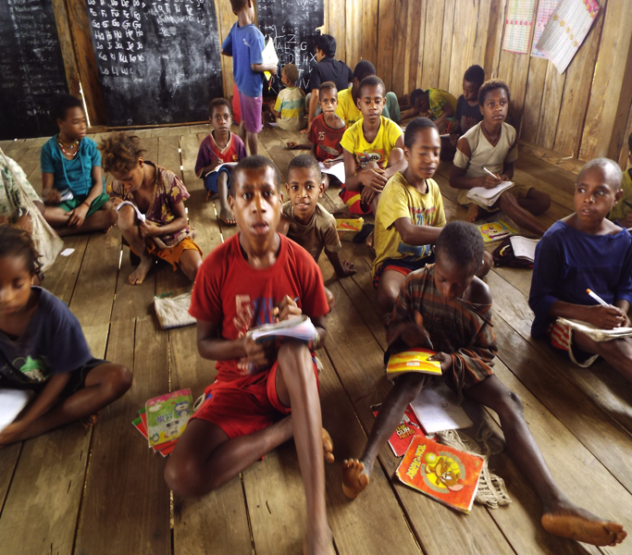
Learning stand in a straight line – ½ hour!
Learning to distinguish right foot first; left foot second…
Second grade class - father of two children enrolled !

Slide 24
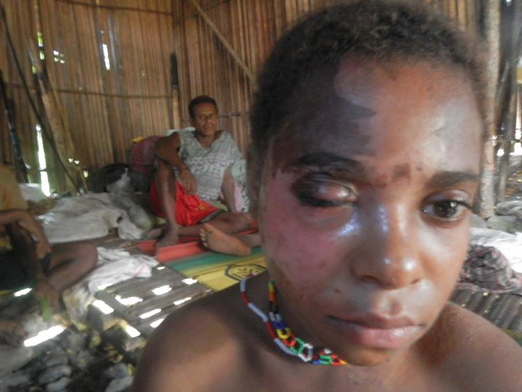
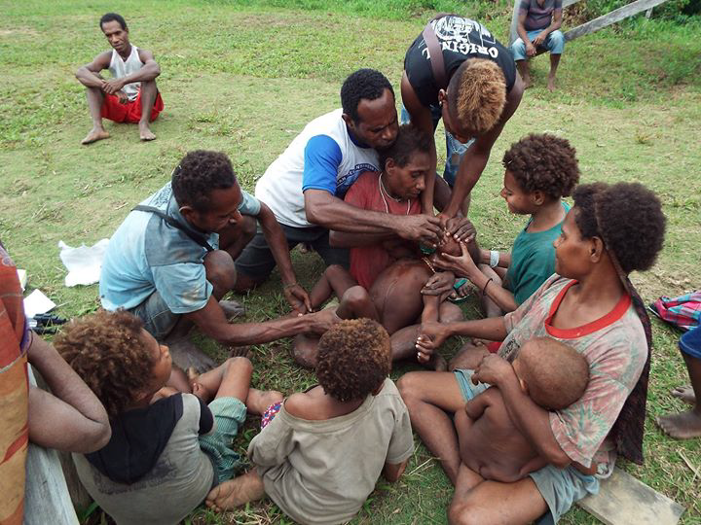
Lack of healthcare in Korowai –
Many suffer from skin diseases and other health problems which can lead to death when untreated.
Malnutrition often leads to preventable disease.

Slide 25
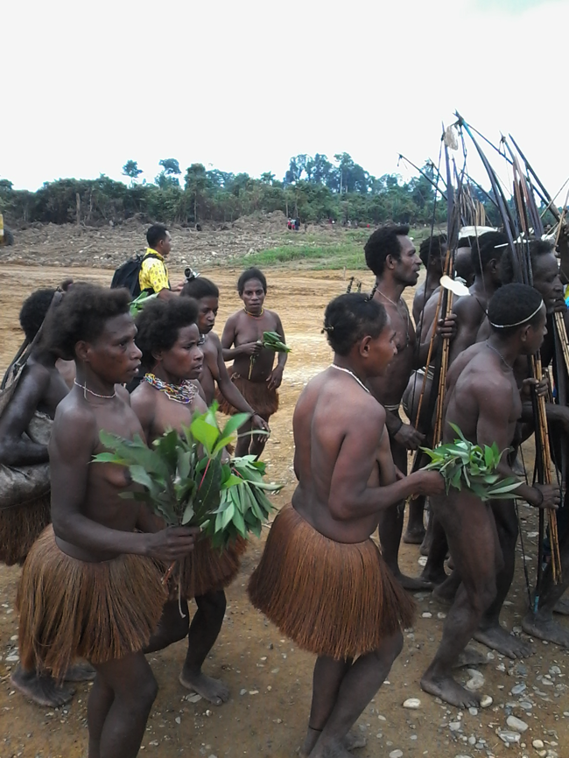
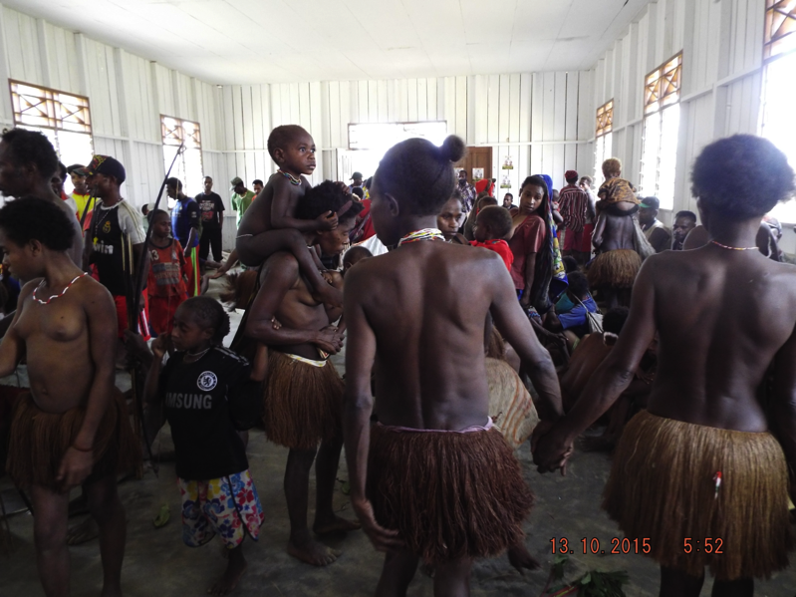
Traditional clothing and ceremony of Korowai people living in the jungles of Papua.

Slide 26
Make Disciples of All Nations...
(Matthew 28:18-20)
Kalimantan

Slide 27
Make Disciples of All Nations: Kalimantan
Notes:
자바 섬에서 복음의 불꽂이 술라웨시로 튀어…

Slide 28
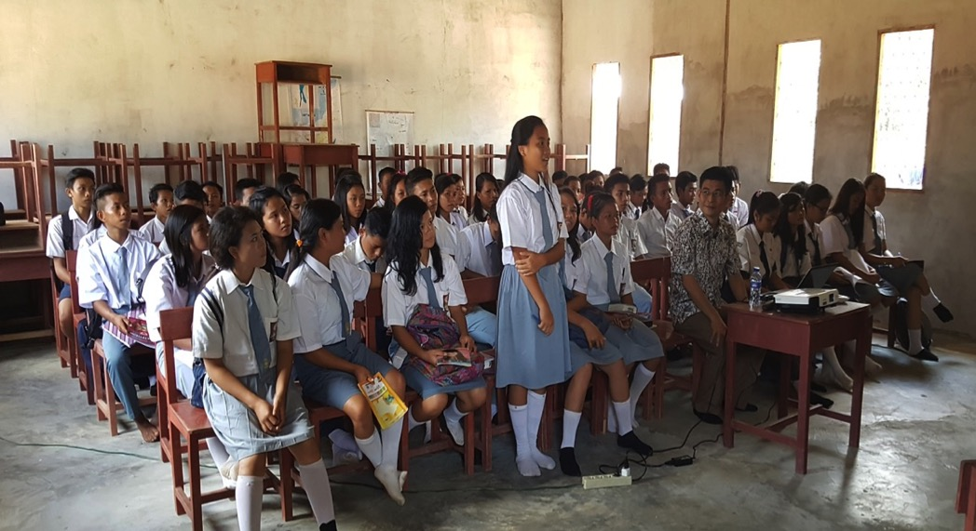
SMP & SMA (Umum)

Slide 29
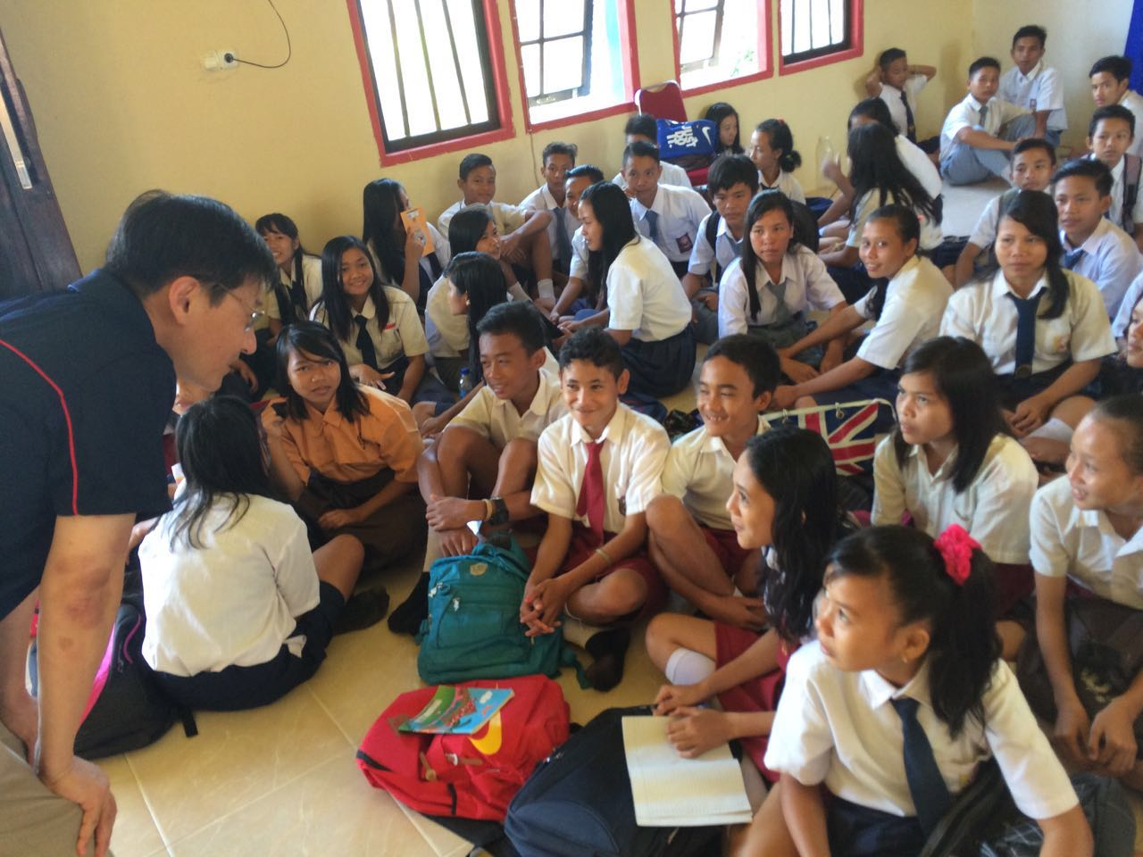
Kelas Bahasa Inggris

Slide 30
7 a.m. Breakfast

Slide 31
4-5 spoons of porridge for breakfast

Slide 32
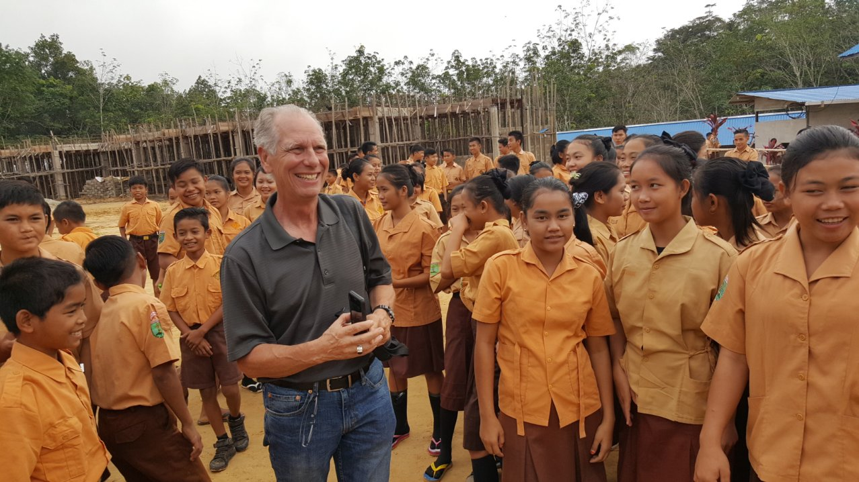
School & Dorm Construction
Notes:
학교 건축중… Dr. Gary Miller story: Talbot 신학교가 소속된 Biola 대학에서 #2; UPH 대하교 총장…
1월에 방문하시고 인도네시아를 섬기기로 헌신 (지금 California에서 기관, 제단, 기독교 교육 network 준비 작업중)…..
만낭의 축복입니다…. 부모의 만남, 주님과의 만남 (영혼한 축복), 그리고 하나님 나라를 세워가는 하나님의 사람을 만나는 축복…얼마나 감사한지요….

Slide 33
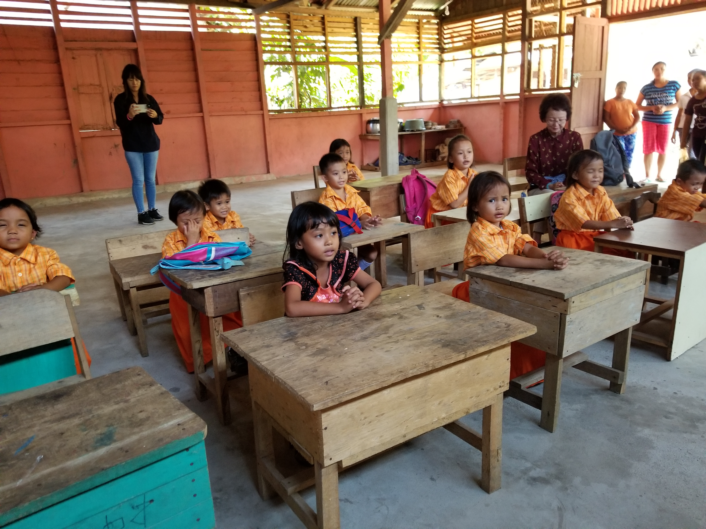

Slide 34
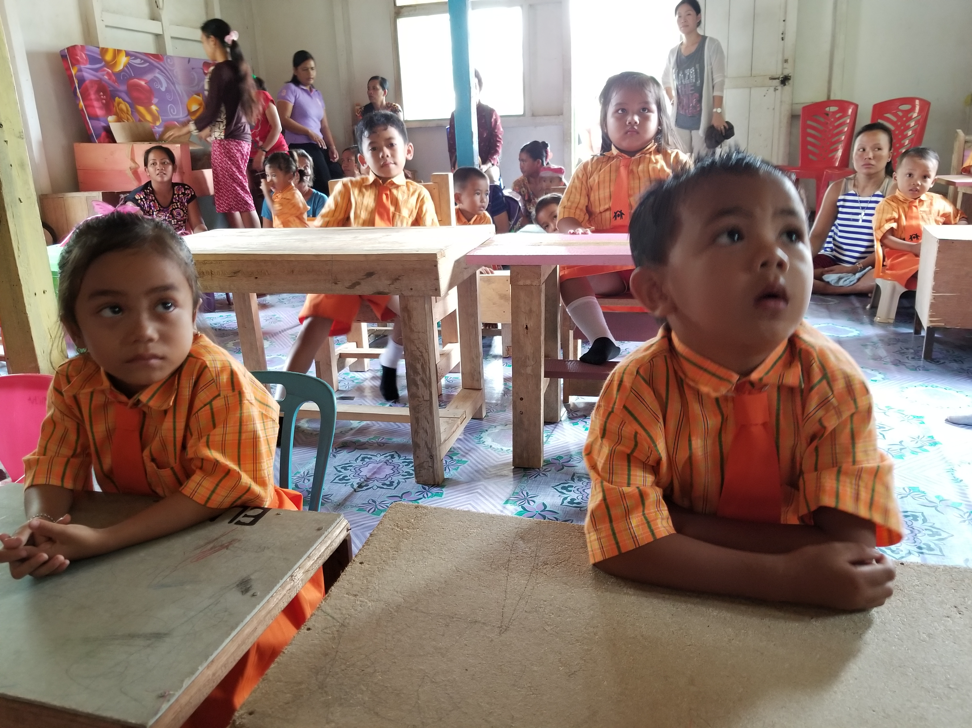

Slide 35
Make Disciples of All Nations: Kalimantan
Notes:
자바 섬에서 복음의 불꽂이 술라웨시로 튀어…

Slide 36
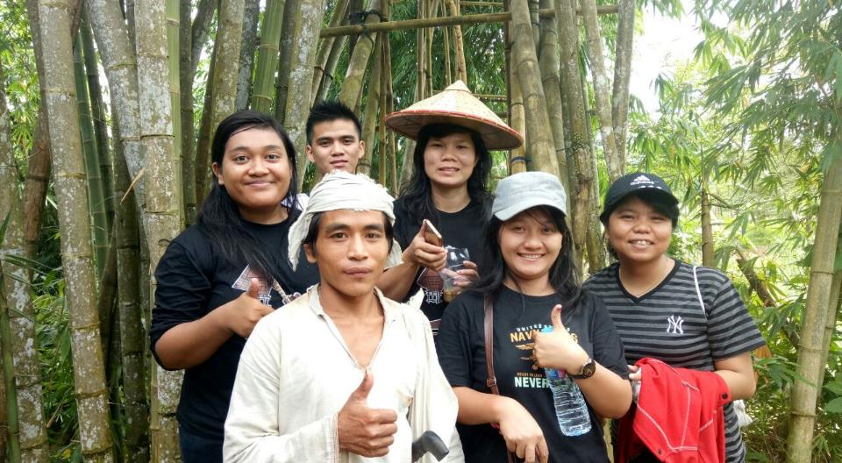
The man (center white clothes) is from a Ba-du-yi tribe, an unreached people group in Indonesia. Virtually no one is a Christ-follower among that people group.
Notes:
The man (center white clothes) is from a Ba-du-yi tribe, an unreached people group in Indonesia. That means virtually no one is a Christ follower among that people group. They live in complete separation from society and no outsider is allowed to live among them, including Muslims. Working with a Christian worker living near the tribe, our seminary team went to spend a couple of weeks along the border. This man from Ba-du-yi tribe came to trust Christ during our outreach.

Slide 37
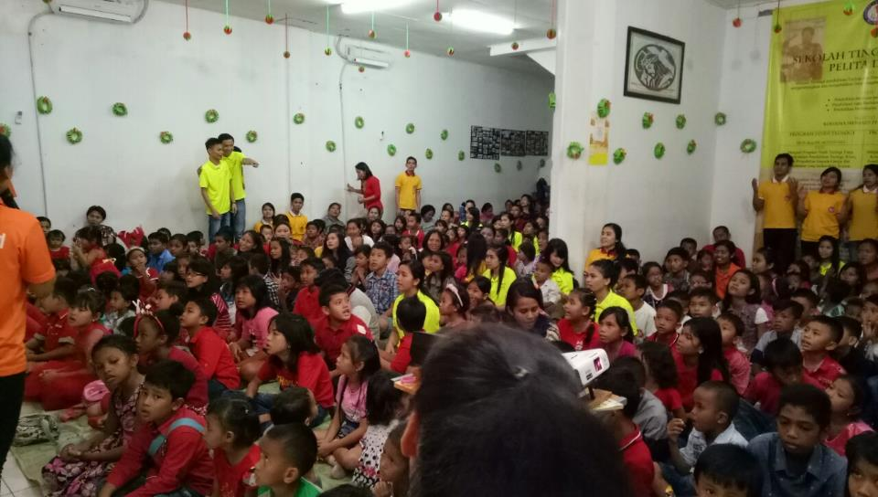
The Good News Club that we operate in many of the Muslim neighborhoods. Christmas party with 300+ children
Notes:
We operate a children’s outreach called, the Good New Club, that we run in many of the Muslim neighborhoods. Our seminary students meet with children in their homes, very often near a mosque or sometimes 2 or 3 mosques in the area. During Christmas season, we invited children to our annual event and shared the gospel with more than 300 children as some received Christ. PTL!

Slide 38
Finally,
What a God-sized Assignment
can look like…

Slide 39
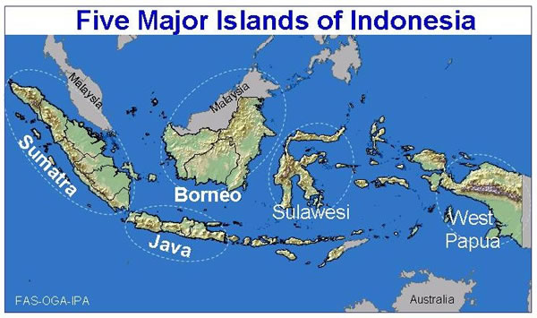
Gospel Sparks Everywhere
Notes:
자바 섬에서 복음의 불꽂이 술라웨시로 튀어…

Slide 40
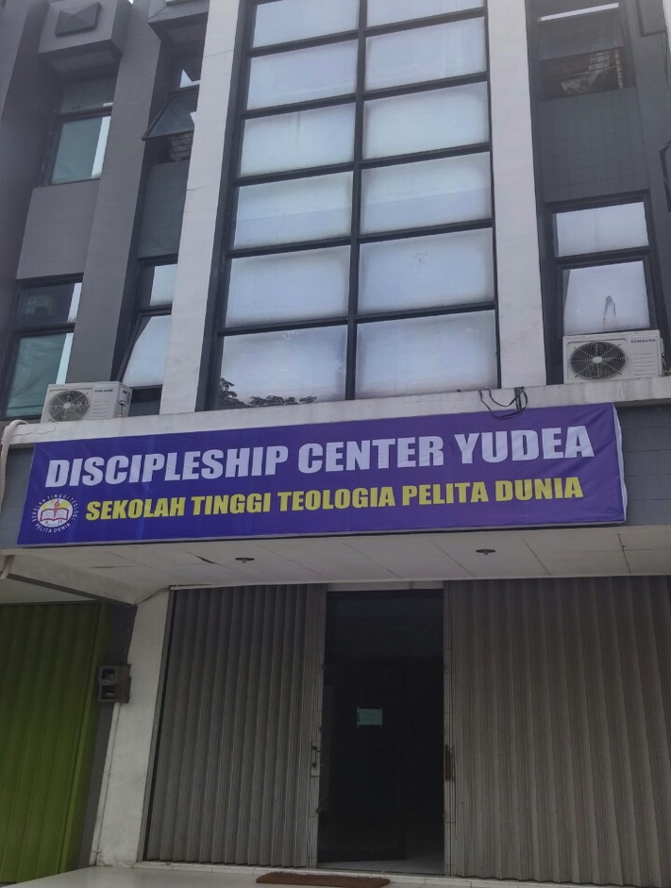
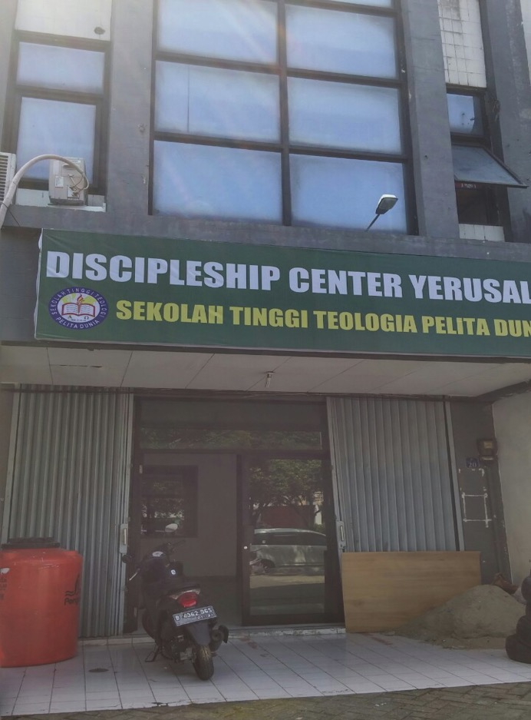
Discipleship Center

Slide 41
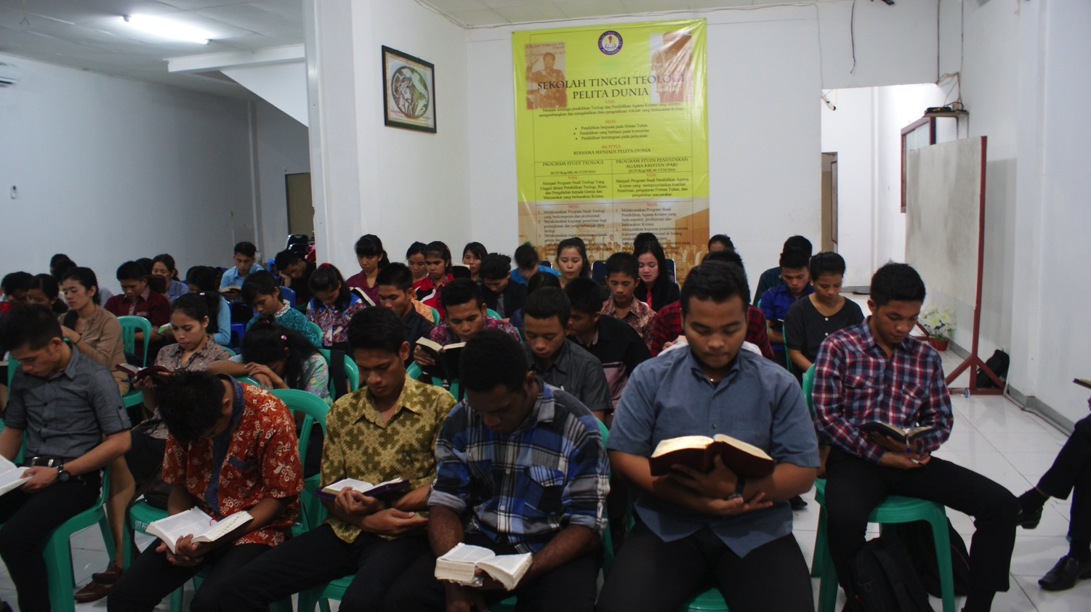
Through the Bible
Notes:
This is another option for an overview slide.

Slide 42
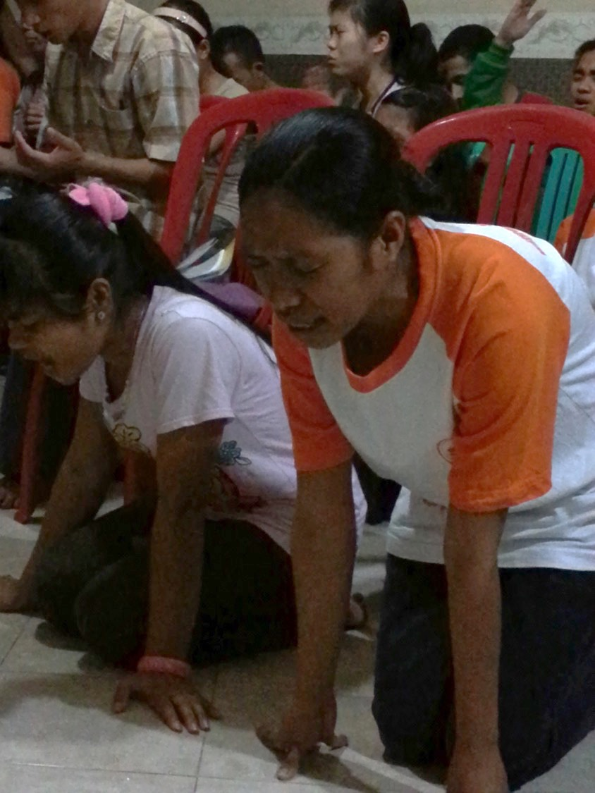
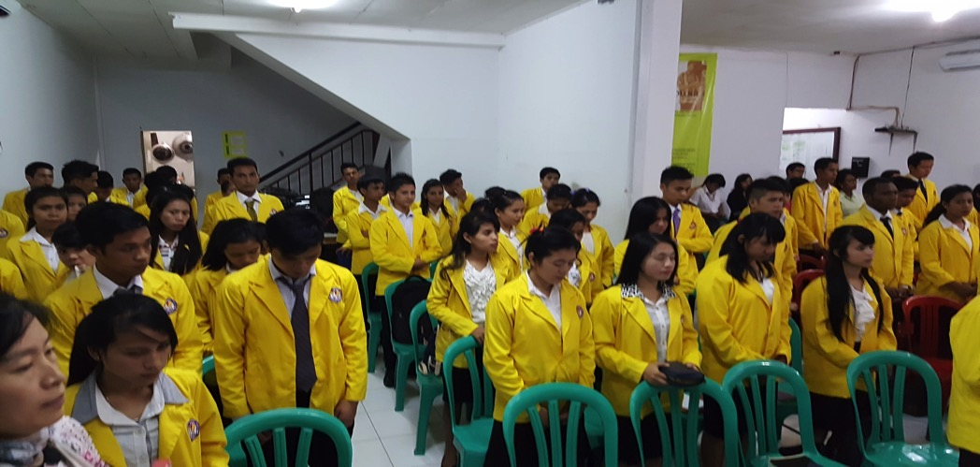
Doa Pagi Morning Prayer
Chapel

Slide 43
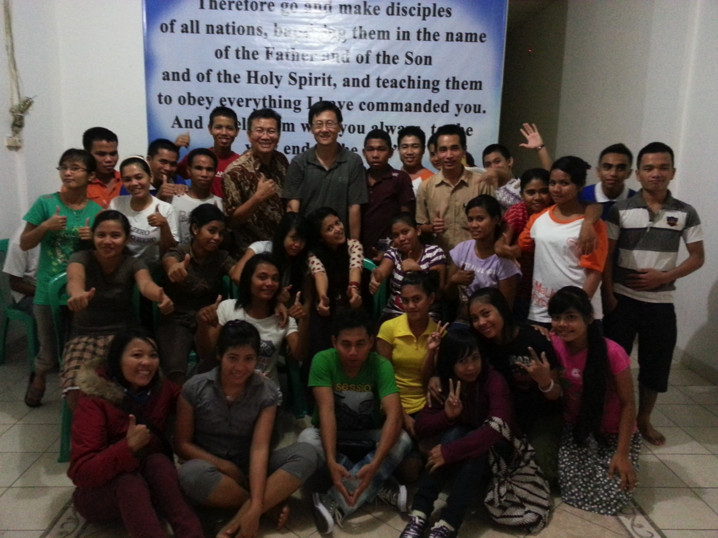
Notes:
This is another option for an overview slide.

Slide 44
Jesus Final Command: “Make Disciples of All Nations…”
God is always at work and invites us to join Him in what He is doing...
What should you do?
Come, see, serve, give, & join Him in His redemptive work.

Slide 45
To Contact or Receive updates:
Email: johnlee0614@gmail.com
“Go Make Disciples of All Nations….”
Matt 28:18-20

Slide 46
THREE PRACTICAL QUESTIONS FOR OUR EVERYDAY LIFE
What one point of this sermon hit home for you? What part of John’s missions work in Indonesia is most encouraging to you?
After 2000 years, why do you think there are still so many unreached people groups? And what can we do about it?
What first step(s) will you take in responding to the Great Commission of Lord Jesus Christ? What would that look like?

