Slide 2
Celebrating & Learning From The Life of Martin Luther King Jr.
A Special Sunday Message
Romans 12:17-21
© January 15, 2017
Wade Harlan
Notes:
2

Slide 3
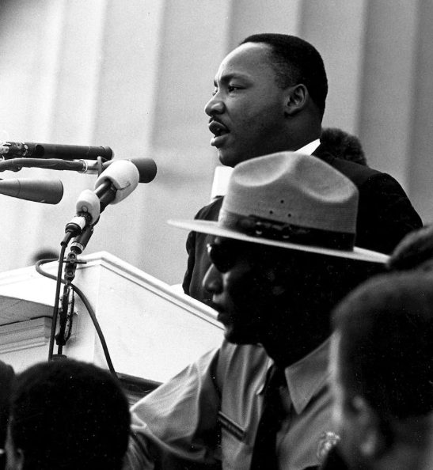
Notes:
3

Slide 4
WHY WE SHOULD CELEBRATE, LEARN FROM AND BE MENTORED BY DR. MARTING LUTHER KING JR.
Scripture teaches that we there is blessing in obeying our authorities.
– Nov 2, 1983 President Reagan made January 15th a national holiday specifically to remember Dr. Martin Luther King Jr. and his cause.
“Pay to all what is owed to them: taxes to whom taxes are owed, revenue to whom revenue is owed, respect to whom respect is owed, honor to whom honor is owed.” – Romans 13:7 [ESV]
Hebrews 11 “Faith Hall of Fame”
We are and should be inspired, mentored and helped by Christian heroes. – both from their victories and defeats.

Slide 5
KEY EVENTS IN MARTIN LUTHER KING JR’S LIFE
Jan 15, 1929 born Michael King.
Age 3 name changed to Michael to Martin Luther King King Jr.
Suffered from depression throughout much of his life.
Age 15, passed exam to enter Morehouse college.
Age 19 graduated w/ BA in Soci0logy.
Age 22 graduated from Crozer Theo. Seminary w/ a B. Div. in theology
Age 24 married wife Coretta Scott (26),
Age 25 called as pastor, Dexter Avenue Baptist Church, Montgomery, AL.
Age 26 received his Ph.D. in Systematic Theology from Boston University
1955, Rosa Parks and the Montgomery bus boycott.

Slide 6
KEY EVENTS IN MARTIN LUTHER KING JR’S LIFE
1957 helped form the Southern Christian Leadership Conference (SCLC)
1958, September, stabbed in the chest
1962 Protests against segregation in Albany, GA
1963 Protests against racial segregation in Birmingham, AL
1963 March on Washington (I have a Dream speech) age 32
1964 Nobel Peace Prize
1965 Selma to Montgomery marches for voting rights, Bloody Sunday
1966 Chicago initiatives against poverty & housing segregation
1966-68 emphasis on poverty and opposition to Vietnam
1968, April 4th, assassinated in Memphis, TN (age 39)

Slide 7
FIVE LESSONS FROM MARTIN LUTHER KING’S LIFE
He believed that Christianity and the Word of God should impact the world.
He showed what it looks like to lay down one’s life for God.
He communicated like Jesus.
He knew that life is a spiritual battle so he boldly stood for the truth and persevered through failure and intense opposition.
His life showed that every Christin is in vital need of genuine, personal accountability.

Slide 8
FIVE LESSONS FROM MARTIN LUTHER KING’S LIFE
1. He believed that Christianity and the Word of God should impact the world.
¹⁷Do not repay anyone evil for evil. Be careful to do what is right in the eyes of everyone. ¹⁸If it is possible, as far as it depends on you, live at peace with everyone. ¹⁹Do not take revenge, my dear friends, but leave room for God’s wrath, for it is written: “It is mine to avenge; I will repay,” says the Lord. ²⁰On the contrary: “If your enemy is hungry, feed him; if he is thirsty, give him something to drink. In doing this, you will heap burning coals on his head.” ²¹Do not be overcome by evil, but overcome evil with good.
— Romans 12:17-21 [NIV]

Slide 9
FIVE LESSONS FROM MARTIN LUTHER KING’S LIFE
2. He showed what it looks like to lay down one’s life for God.
His comment to Coretta after the John F. Kennedy’s assassination.
His speech the night before his assassination.

Slide 10
FIVE LESSONS FROM MARTIN LUTHER KING’S LIFE
3. He communicated like Jesus.
Memorable
Impactful
Video clip from King: Man of Peace in a Time of War

Slide 11
FIVE LESSONS FROM MARTIN LUTHER KING’S LIFE
4. He knew that life is a spiritual battle so he boldly stood for the truth and persevered through failure and intense opposition.
Comments by Malcolm X.
Actions of J. Edgar Hoover and the FBI.
He modeled incarnational ministry.

Slide 12
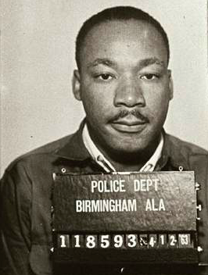
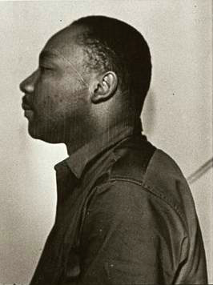

Slide 13
FIVE LESSONS FROM MARTIN LUTHER KING’S LIFE
5. His life showed that every Christian is in vital need of genuine, personal accountability.
The testimony of Ralph Abernathy, his best friend and successor as president of the SCLC.

Slide 14
APPLICATIONS
Emulate and put into practice some of these 5 lessons from Martin Luther King Jr.’s life
Stand up in a godly way for injustice when you see it.
“Justice anywhere threatens justice everywhere.”
Consider watching Selma (will need to edit some parts) tomorrow or some other good movie on this life.
They Were There: Remembering The Civil Rights Movement (Jim Lehrer News Hour Interviews)
Consider attending a MLK Memorial Service tomorrow at an Evangelical African-American church.
Notes:
- Send ideas to one

Slide 15
THREE PRACTICAL QUESTIONS FOR OUR EVERYDAY LIFE
What is one thing you’d like to do differently in your life as a result of Martin Luther King’s life.
What is one way that you’d like to see your faith have more impact outside our church walls.
Do you have the kind of accountability you need in your life for the areas where you are most vulnerable to harming yours and God’s reputation?

