Slide 2
Minding Your Joy In the Christian Life
A Special Sunday Message
Philippians 1:1-30
© January 14, 2018
Wade Harlan
Notes:
2

Slide 3
Background to Philippians
Written to: the church at Philippi
- Went there on his 2nd missionary journey

Slide 4
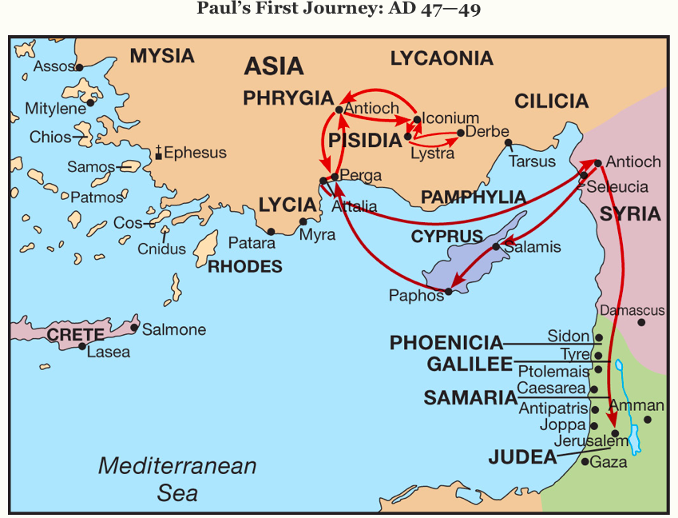

Slide 5
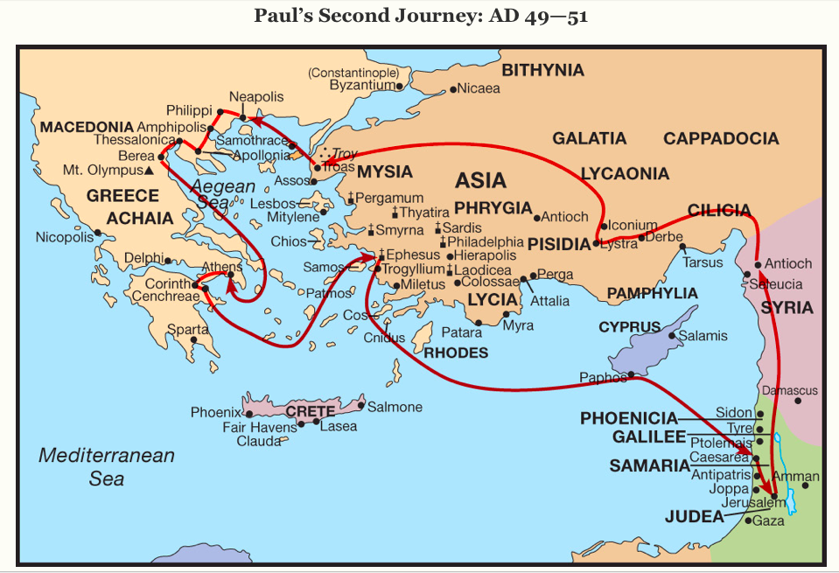

Slide 6
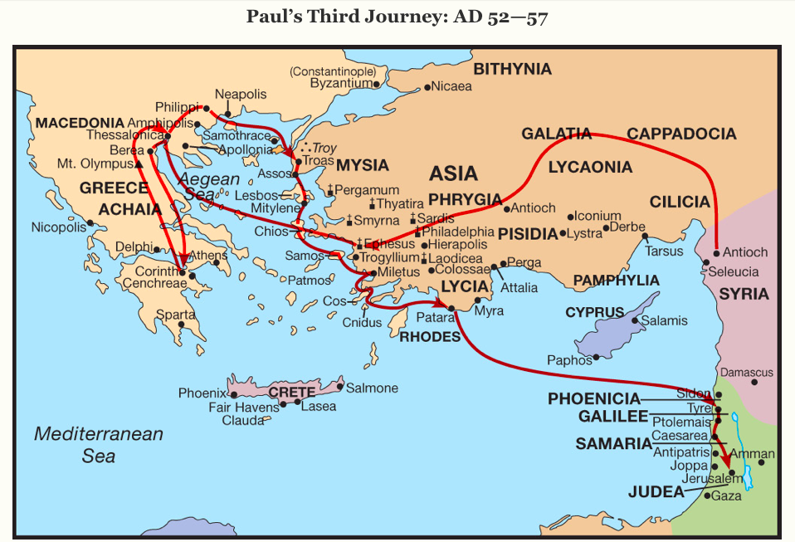

Slide 7
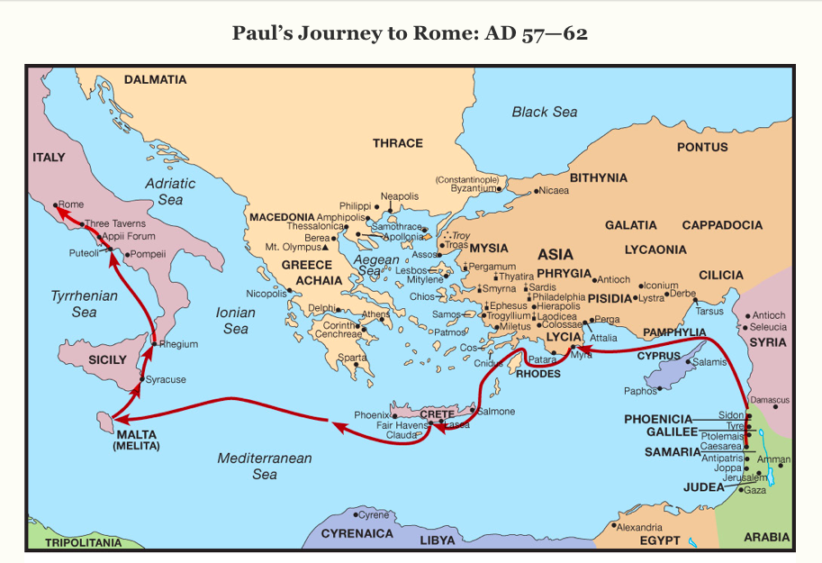
Notes:
We don’t know what happened to Paul after Rome. He hoped to go to Spain.

Slide 8
Background to Philippians
Written to: the church at Philippi
- went there for several days on his 2nd missionary journey (Acts 16)
saw Lydia and her family believe and be baptized
cast a demon out of a slave girl who predicted the future/told fortunes.
He and Silas stripped and severely beaten with rods in public and imprisoned even though they were Roman citizens.
…though we had already suffered and been shamefully treated at Philippi, as you know, we had boldness in our God to declare to you the gospel of God in the midst of much conflict. 2 Thess. 2:2
met the Philippian jailor and saw his family’s believe and be baptized
a church was started sometime after his 2nd missionary journey there
he visited them on his 3rd missionary journey for Feast of Unleavened Bread*
Notes:
- Cast a demon out of a Slave girl who predicted the future/told fortunes. He and Silas stripped and severely flogged in public and imprisoned even though they were Roman citizens.
- Another reason we can Consider it pure joy, my brothers and sisters, whenever you face trials of many kinds, 3 because you know that the testing of your faith produces perseverance. 4 Let perseverance finish its work so that you may be mature
*Passover – celebrated for a week

Slide 9
Background to Philippians
the Philippians helped/partnered with him in his ministry
Through prayer
Financially. 3 times - twice when Paul was at Thessalonica, and once when he was at Corinth (Phil. 4:18; cf. 2 Cor. 11:9) - the Philippians met his needs.
Relationally. They sent Epaphroditus (Phil 2:25) to take care of his needs while imprisoned in Rome.)
Notes:
- Cast a demon out of a Slave girl who predicted the future/told fortunes. He and Silas stripped and severely flogged in public and imprisoned even though they were Roman citizens.
- Another reason we can Consider it pure joy, my brothers and sisters, whenever you face trials of many kinds, 3 because you know that the testing of your faith produces perseverance. 4 Let perseverance finish its work so that you may be mature
*Passover – celebrated for a week

Slide 10
Background to Philippians
Purpose of the book:
To thank them
To encourage them
- to be joyful
- to think rightly about the Christian life
3) To briefly address problem areas
- with rivalry and personal ambition (2:3-4; 4:2).
- the Judaizers were gaining influence (3:1-3).
- worldliness was creeping in (3:18-19).

Slide 11
Philippians 1: 1-2
¹ Paul and Timothy, servants of Christ Jesus,
To all the saints in Christ Jesus who are at Philippi, with the overseers and deacons:
²Grace to you and peace from God our Father and the Lord Jesus Christ.

Slide 12
Philippians 1: 1-2
¹ Paul and Timothy, servants of Christ Jesus,
To all the saints in Christ Jesus who are at Philippi, with the overseers and deacons:
²Grace to you and peace from God our Father and the Lord Jesus Christ.
Notes:
He was always surrounded himself and was partnering with other people. Timothy, Epaphroditus, Euodia and I entreat Syntyche to agree in the Lord …. These women labored side by side with me in the gospel together with Clement and the rest of my fellow workers,
Why he had some much JOY. Seeing people find and use their giftings.
Paul’s joy was in people, not in his circumstances. His circumstances would have caused him to be repulsed and reject them –the place where he was stripped and beaten. Yet it
DISS is it. Death Illness Sickness Significant events.

Slide 13
Philippians 1: 1-2
¹ Paul and Timothy, servants of Christ Jesus,
To all the saints in Christ Jesus who are at Philippi, with the overseers and deacons:
²Grace to you and peace from God our Father and the Lord Jesus Christ.
- - - - - - - - - - - - - -
¹⁹ I hope in the Lord Jesus to send Timothy to you soon, so that I too may be cheered by news of you. ²⁰ For I have no one like him, who will be genuinely concerned for your welfare. ²¹ For they all seek their own interests, not those of Jesus Christ. ²² But you know Timothy's proven worth, how as a son with a father he has served with me in the gospel. Philippians 2:19-22 (ESV)
Notes:
God what are you interested in doing in the lives of the people in my men’s group/ men’s team gathering (Not men’s team meeting)?

Slide 14
Philippians 1: 1-2
¹ Paul and Timothy, servants of Christ Jesus,
To all the saints in Christ Jesus who are at Philippi, with the overseers and deacons:
²Grace to you and peace from God our Father and the Lord Jesus Christ.
“saint” – (hágios) holy, set apart, different, means "likeness of nature with the Lord" because we are "different from the world.”
- An example for us today
Notes:
Amy Sullivan ,Christian journalist in her recent NY Times article about Evangelicals role in the recent election said this “Journalists and scholars have spent decades examining the influence of conservative religion on American politics, but we largely missed the impact conservative politics was having on religion itself. What researchers recently discovered was that while one-quarter of Americans consider themselves to be “evangelical,” less than half of that group actually holds traditional evangelical beliefs. For others, “evangelical” effectively functions as a cultural label, unmoored from theological meaning. Amy Sullivan followed a pastor on his quest to convince fellow evangelicals of his belief that pro-life values are incompatible with an embrace of total unrestricted gun access including assault rifles, She found the pastor’s documentary compelling, but was surpirzed by the response of the North Dakota audience. As two dozen of us gathered for a post-screening discussion, I was both astonished and troubled, as a fellow evangelical, by the visceral sense of fear that gripped these young adults. As a child in the Baptist church, I had been taught to be vigilant about real threats to my faith. But these students in a town with a population of some 1,200 saw the idea of a home invasion or an Islamic State attack that would require them to take a human life in order to save others as a certainty they would face, not a hypothetical. These fears are far removed from the reality of life in North Dakota, a state that saw a total of 21 homicides in 2015. Of those deaths, seven were caused by firearms, and only three were committed by someone unknown to the victim. Yet the students around me asserted that “in the world around us, there are terrorists, home invaders, drug cartels, carjackers, knockout gamers, rapers, haters, campus killers, airport killers, shopping mall killers.”
This worldview is familiar to anyone who has spent time watching the news broadcasts, where every day viewers are confronted with threats to their way of life. One of the most consistent messages of the Bible is the exhortation “Do not be afraid!” Before young evangelicals can read, we memorize verses reminding us to “be strong and courageous” and “trust in the Lord.” “Fear,” says the documentary, “should not be a controlling element in the life of a Christian.”
That disconnect underscores the challenge many pastors face in trying to shepherd congregants who are increasingly alienated from traditional Gospel teachings. “A pastor has about 30 to 40 minutes each week to teach about Scripture,” said Jonathan Martin, an Oklahoma pastor and popular evangelical writer. “but they’ve been exposed to secular News potentially three to four hours a day.” My own watching of late-night TV shows monologues – continually laughing at/mocking the President. “Pray for kings and all who are in high positions, that we may lead a peaceful and quiet life, godly and dignified in every way. Changed hearts change the world.

Slide 15
Philippians 1: 3-11
³I thank my God in all my remembrance of you, ⁴always in every prayer of mine for you all making my prayer with joy, ⁵because of your partnership in the gospel from the first day until now. ⁶And I am sure of this, that he who began a good work in you will bring it to completion at the day of Jesus Christ. ⁷It is right for me to feel this way about you all, because I hold you in my heart, for you are all partakers with me of grace, both in my imprisonment and in the defense and confirmation of the gospel. ⁸For God is my witness, how I yearn for you all with the affection of Christ Jesus. ⁹And it is my prayer that your love may abound more and more, with knowledge and all discernment, ¹⁰so that you may approve what is excellent, and so be pure and blameless for the day of Christ, ¹¹filled with the fruit of righteousness that comes through Jesus Christ, to the glory and praise of God.
Notes:
Let’s look at it differently using a tool called scripture diagramming.

Slide 16
³I thank my God
every time I remember you.
⁴In all my prayers for all of you
I always pray with joy
⁵because of your partnership in the gospel from the first day until now,
⁶being confident of this, that he who began a good work in you will carry it on to completion until the day of Christ Jesus.
⁷It is right for me to feel this way about all of you
since I have you in my heart and
whether I am in chains or defending and confirming the gospel, all of you share in God’s grace with me.
⁸God can testify how I long for all of you with the affection of Christ Jesus.
Notes:
Shows the structure of the argument. NIV
Every time I remember you.

Slide 17
⁹And this is my prayer:
that your love may abound more and more
in knowledge and depth of insight
¹⁰so that you may be able to
discern what is best and
may be pure and blameless for the day of Christ
¹¹filled with the fruit of righteousness
that comes through Jesus Christ (and is for) the glory and praise of God.
Key Question: Where do we find lasting joy in our lives?
Answer: Where Paul found it.
Notes:
In verses 3-11 what are the things that brought Paul joy? (giving, mutual encouraging, sending someone to care for and encourage), like w/ Bo & Cindy/us
- God and people
- partnering with people for the sake of God’s kingdom
- thanksgiving, gratefulness & prayer come osut of this
- partnering and prayer sprang out of and reflected this joy.
Application:
Where are we looking for and finding lasting deep-seated joy? Is it in partnering in ministry with people for the sake of God’s kingdom?
- Dr.Brownlee and his wife – Starry Night – paint

Slide 18
³I thank my God
every time I remember you.
⁴In all my prayers for all of you
I always pray with joy
⁵because of your partnership in the gospel from the first day until now,
⁶being confident of this, that he who began a good work in you will carry it on to completion until the day of Christ Jesus.
⁷It is right for me to feel this way about all of you
since I have you in my heart and
whether I am in chains or defending and confirming the gospel, all of you share in God’s grace with me.
⁸God can testify how I long for all of you with the affection of Christ Jesus.
Notes:
Shows the structure of the argument. NIV
Every time I remember you.

Slide 19
³I thank my God
every time I remember you.
⁴In all my prayers for all of you
I always pray with joy
⁵because of your partnership in the gospel from the first day until now,
⁶being confident of this, that he who began a good work in you will carry it on to completion until the day of Christ Jesus.
⁷It is right for me to feel this way about all of you
since I have you in my heart and
whether I am in chains or defending and confirming the gospel, all of you share in God’s grace with me.
⁸God can testify how I long for all of you with the affection of Christ Jesus.
Notes:
They bring him joy so he prays and as he prays & gives thanks he’s filled with joy

Slide 20
³I thank my God
every time I remember you.
⁴In all my prayers for all of you
I always pray with joy
⁵because of your partnership in the gospel from the first day until now,
⁶being confident of this, that he who began a good work in you will carry it on to completion until the day of Christ Jesus.
⁷It is right for me to feel this way about all of you
since I have you in my heart and
whether I am in chains or defending and confirming the gospel, all of you share in God’s grace with me.
⁸God can testify how I long for all of you with the affection of Christ Jesus.
Notes:
They partnered together – give and take of helping each other, they were bonded together.

Slide 21
³I thank my God
every time I remember you.
⁴In all my prayers for all of you
I always pray with joy
⁵because of your partnership in the gospel from the first day until now,
⁶being confident of this, that he who began a good work in you will carry it on to completion until the day of Christ Jesus.
⁷It is right for me to feel this way about all of you
since I have you in my heart and
whether I am in chains or defending and confirming the gospel, all of you share in God’s grace with me.
⁸God can testify how I long for all of you with the affection of Christ Jesus.
Notes:
Shows the structure of the argument. NIV
Every time I remember you.

Slide 22
³I thank my God
every time I remember you.
⁴In all my prayers for all of you
I always pray with joy
⁵because of your partnership in the gospel from the first day until now,
⁶being confident of this, that he who began a good work in you will carry it on to completion until the day of Christ Jesus.
⁷It is right for me to feel this way about all of you
since I have you in my heart and
whether I am in chains or defending and confirming the gospel, all of you share in God’s grace with me.
⁸God can testify how I long for all of you with the affection of Christ Jesus.
Notes:
Shows the structure of the argument. NIV
Every time I remember you.

Slide 23
³I thank my God
every time I remember you.
⁴In all my prayers for all of you
I always pray with joy
⁵because of your partnership in the gospel from the first day until now,
⁶being confident of this, that he who began a good work in you will carry it on to completion until the day of Christ Jesus.
⁷It is right for me to feel this way about all of you
since I have you in my heart and
whether I am in chains or defending and confirming the gospel, all of you share in God’s grace with me.
⁸God can testify how I long for all of you with the affection of Christ Jesus.
Notes:
Shows the structure of the argument. NIV

Slide 24
³I thank my God
every time I remember you.
⁴In all my prayers for all of you
I always pray with joy
⁵because of your partnership in the gospel from the first day until now,
⁶being confident of this, that he who began a good work in you will carry it on to completion until the day of Christ Jesus.
⁷It is right for me to feel this way about all of you
since I have you in my heart and
whether I am in chains or defending and confirming the gospel, all of you share in God’s grace with me.
⁸God can testify how I long for all of you with the affection of Christ Jesus.
Key Question: Where do we find lasting joy in our lives? Where Paul found it. In people. In partnering in ministry with people for the sake of God’s kingdom?
Notes:
Joy comes from partnering with people for the sake of God’s kingdom. Through difficulties and trauma, they were bonded together.
He had a perspective that God uses it all for good. People are messy. Unlimited teams, unlimited problems.

Slide 25
Because of this bonded relationship, how does Paul pray for them?
⁹And this is my prayer:
that your love may abound more and more
in knowledge and depth of insight
¹⁰so that you may be able to
discern what is best and
may be pure and blameless for the day of Christ
¹¹filled with the fruit of righteousness
that comes through Jesus Christ (and is for) the glory and praise of God.
Notes:
How he prays b/c of this for their love (for God and others)

Slide 26
Because of this bonded relationship, how does Paul pray for them?
⁹And this is my prayer:
that your love may abound more and more
in knowledge and depth of insight
¹⁰so that you may be able to
discern what is best and
may be pure and blameless for the day of Christ
¹¹filled with the fruit of righteousness
that comes through Jesus Christ (and is for) the glory and praise of God.
Notes:
How he prays b/c of this for their love (for God and others)

Slide 27
Because of this bonded relationship, how does Paul pray for them?
⁹And this is my prayer:
that your love may abound more and more
in knowledge and depth of insight
¹⁰so that you may be able to
discern what is best and
may be pure and blameless for the day of Christ
¹¹filled with the fruit of righteousness
that comes through Jesus Christ (and is for) the glory and praise of God.
Notes:
How he prays b/c of this for their love (for God and others)

Slide 28
Because of this bonded relationship, how does Paul pray for them?
⁹And this is my prayer:
that your love may abound more and more
in knowledge and depth of insight
¹⁰so that you may be able to
discern what is best and
may be pure and blameless for the day of Christ
¹¹filled with the fruit of righteousness
that comes through Jesus Christ (and is for) the glory and praise of God.
Notes:
How he prays b/c of this for their love (for God and others)

Slide 29
Because of this bonded relationship, how does Paul pray for them?
⁹And this is my prayer:
that your love may abound more and more
in knowledge and depth of insight
¹⁰so that you may be able to
discern what is best and
may be pure and blameless for the day of Christ
¹¹filled with the fruit of righteousness
that comes through Jesus Christ (and is for) the glory and praise of God.
Notes:
How he prays b/c of this for their love (for God and others)

Slide 30
Because of this bonded relationship, how does Paul pray for them?
⁹And this is my prayer:
that your love may abound more and more
in knowledge and depth of insight
¹⁰so that you may be able to
discern what is best and
may be pure and blameless for the day of Christ
¹¹filled with the fruit of righteousness
that comes through Jesus Christ (and is for) the glory and praise of God.
Notes:
How he prays b/c of this for their love (for God and others)

Slide 31
Because of this bonded relationship, how does Paul pray for them?
⁹And this is my prayer:
that your love may abound more and more
in knowledge and depth of insight
¹⁰so that you may be able to
discern what is best and
may be pure and blameless for the day of Christ
¹¹filled with the fruit of righteousness
that comes through Jesus Christ (and is for) the glory and praise of God.
Notes:
How he prays b/c of this for their love (for God and others)

Slide 32
Dr. Brownlee in Chin

Slide 33
Notes:
Starry, starry night. Paint your pallet blue and gray
Look out on a summer’s day ….
Sketch the trees and the daffodils,
Catch the breeze and the winter chills
in colors on the snowy wintry night.

Slide 34
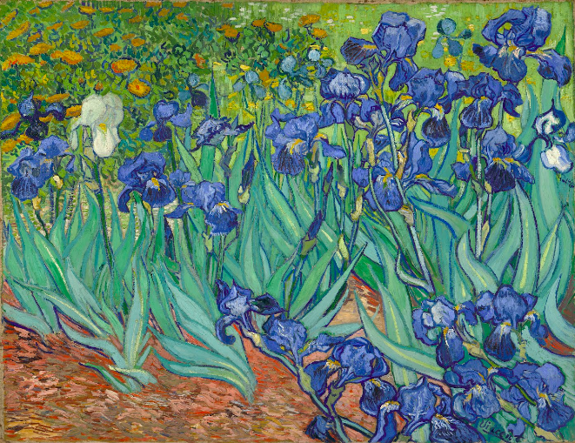
Notes:
Starry, starry night. Flaming flowers that brightly blaze
Swirling clouds in violet haze,
Reflect in Vincent’s eyes of china blue.
Colors changing hue.
Morning fields of amber grain.
Weathered faces lined in pain, Are soothed beneath the artist’s loving hand. They’d partnered in ministry for the sake of God’s kingdom?
Give yourself to people. It’s messy. Unlimited teams – unlimited problems.

Slide 35
Philippians 1:12-18
¹²I want you to know, brothers, that what has happened to me has really served to advance the gospel, ¹³so that it has become known throughout the whole imperial guard and to all the rest that my imprisonment is for Christ. ¹⁴And most of the brothers, having become confident in the Lord by my imprisonment, are much more bold to speak the word without fear. ¹⁵Some indeed preach Christ from envy and rivalry, but others from good will. ¹⁶The latter do it out of love, knowing that I am put here for the defense of the gospel. ¹⁷The former proclaim Christ out of selfish ambition, not sincerely but thinking to afflict me in my imprisonment. ¹⁸What then? Only that in every way, whether in pretense or in truth, Christ is proclaimed, and in that I rejoice.

Slide 36
Philippians 1:12-18
¹²I want you to know, brothers, that what has happened to me has really served to advance the gospel, ¹³so that it has become known throughout the whole imperial guard and to all the rest that my imprisonment is for Christ. ¹⁴And most of the brothers, having become confident in the Lord by my imprisonment, are much more bold to speak the word without fear. ¹⁵Some indeed preach Christ from envy and rivalry, but others from good will. ¹⁶The latter do it out of love, knowing that I am put here for the defense of the gospel. ¹⁷The former proclaim Christ out of selfish ambition, not sincerely but thinking to afflict me in my imprisonment. ¹⁸What then? Only that in every way, whether in pretense or in truth, Christ is proclaimed, and in that I rejoice.
Key Truth: We must develop a deep, solid, conviction that are joy is not dependent on our circumstances. An anchor that holds in the storm.

Slide 37
Philippians 1:12-18
¹²I want you to know, brothers, that what has happened to me has really served to advance the gospel, ¹³so that it has become known throughout the whole imperial guard and to all the rest that my imprisonment is for Christ. ¹⁴And most of the brothers, having become confident in the Lord by my imprisonment, are much more bold to speak the word without fear. ¹⁵Some indeed preach Christ from envy and rivalry, but others from good will. ¹⁶The latter do it out of love, knowing that I am put here for the defense of the gospel. ¹⁷The former proclaim Christ out of selfish ambition, not sincerely but thinking to afflict me in my imprisonment. ¹⁸What then? Only that in every way, whether in pretense or in truth, Christ is proclaimed, and in that I rejoice.
Key Truth: We must develop a deep, solid, conviction that are joy is not dependent on our circumstances. An anchor that holds in the storm.

Slide 38
Philippians 1:12-18
¹²I want you to know, brothers, that what has happened to me has really served to advance the gospel, ¹³so that it has become known throughout the whole imperial guard and to all the rest that my imprisonment is for Christ. ¹⁴And most of the brothers, having become confident in the Lord by my imprisonment, are much more bold to speak the word without fear. ¹⁵Some indeed preach Christ from envy and rivalry, but others from good will. ¹⁶The latter do it out of love, knowing that I am put here for the defense of the gospel. ¹⁷The former proclaim Christ out of selfish ambition, not sincerely but thinking to afflict me in my imprisonment. ¹⁸What then? Only that in every way, whether in pretense or in truth, Christ is proclaimed, and in that I rejoice.
Key Truth: We must develop a deep, solid, conviction that are joy is not dependent on our circumstances. An anchor that holds in the storm.

Slide 39
Philippians 1:12-18
¹²I want you to know, brothers, that what has happened to me has really served to advance the gospel, ¹³so that it has become known throughout the whole imperial guard and to all the rest that my imprisonment is for Christ. ¹⁴And most of the brothers, having become confident in the Lord by my imprisonment, are much more bold to speak the word without fear. ¹⁵Some indeed preach Christ from envy and rivalry, but others from good will. ¹⁶The latter do it out of love, knowing that I am put here for the defense of the gospel. ¹⁷The former proclaim Christ out of selfish ambition, not sincerely but thinking to afflict me in my imprisonment. ¹⁸What then? Only that in every way, whether in pretense or in truth, Christ is proclaimed, and in that I rejoice.
Key Truth: We must develop a deep, solid, conviction that are joy is not dependent on our circumstances. An anchor that holds in the storm.

Slide 40
Philippians 1:12-18
¹²I want you to know, brothers, that what has happened to me has really served to advance the gospel, ¹³so that it has become known throughout the whole imperial guard and to all the rest that my imprisonment is for Christ. ¹⁴And most of the brothers, having become confident in the Lord by my imprisonment, are much more bold to speak the word without fear. ¹⁵Some indeed preach Christ from envy and rivalry, but others from good will. ¹⁶The latter do it out of love, knowing that I am put here for the defense of the gospel. ¹⁷The former proclaim Christ out of selfish ambition, not sincerely but thinking to afflict me in my imprisonment. ¹⁸What then? Only that in every way, whether in pretense or in truth, Christ is proclaimed, and in that I rejoice.
¹⁸But what does it matter? The important thing is that in every way, whether from false motives or true, Christ is preached. And because of this I rejoice. (NIV)
Notes:
(NIV) 18 But what does it matter? The important thing is that in every way, whether from false motives or true, Christ is preached. And because of this I rejoice.

Slide 41
Philippians 1:12-18
Key Truth: We must develop a deep, solid, conviction that are joy is not dependent on our circumstances.
²⁸ And we know that in all things God works for the good of those who love him, who have been called according to his purpose. Romans 8:28 (NIV)
God allows nothing in our lives to happen except those things that we too would chose if we could but see things from His perspective. Robert Wilder
Notes:
An anchor that holds in the storm. Rom 8:28

Slide 42
Philippians 1:19-26
Yes, and I will rejoice, ¹⁹for I know that through your prayers and the help of the Spirit of Jesus Christ this will turn out for my deliverance, ²⁰as it is my eager expectation and hope that I will not be at all ashamed, but that with full courage now as always Christ will be honored in my body, whether by life or by death. ²¹For to me to live is Christ, and to die is gain. ²²If I am to live in the flesh, that means fruitful labor for me. Yet which I shall choose I cannot tell. ²³I am hard pressed between the two. My desire is to depart and be with Christ, for that is far better. ²⁴But to remain in the flesh is more necessary on your account. ²⁵Convinced of this, I know that I will remain and continue with you all, for your progress and joy in the faith, ²⁶so that in me you may have ample cause to glory in Christ Jesus, because of my coming to you again.

Slide 43
Philippians 1:19-26
Yes, and I will rejoice, ¹⁹for I know that through your prayers and the help of the Spirit of Jesus Christ this will turn out for my deliverance, ²⁰as it is my eager expectation and hope that I will not be at all ashamed, but that with full courage now as always Christ will be honored in my body, whether by life or by death. ²¹For to me to live is Christ, and to die is gain. ²²If I am to live in the flesh, that means fruitful labor for me. Yet which I shall choose I cannot tell. ²³I am hard pressed between the two. My desire is to depart and be with Christ, for that is far better. ²⁴But to remain in the flesh is more necessary on your account. ²⁵Convinced of this, I know that I will remain and continue with you all, for your progress and joy in the faith, ²⁶so that in me you may have ample cause to glory in Christ Jesus, because of my coming to you again.

Slide 44
Philippians 1:19-26
Yes, and I will rejoice, ¹⁹for I know that through your prayers and the help of the Spirit of Jesus Christ this will turn out for my deliverance, ²⁰as it is my eager expectation and hope that I will not be at all ashamed, but that with full courage now as always Christ will be honored in my body, whether by life or by death. ²¹For to me to live is Christ, and to die is gain. ²²If I am to live in the flesh, that means fruitful labor for me. Yet which I shall choose I cannot tell. ²³I am hard pressed between the two. My desire is to depart and be with Christ, for that is far better. ²⁴But to remain in the flesh is more necessary on your account. ²⁵Convinced of this, I know that I will remain and continue with you all, for your progress and joy in the faith, ²⁶so that in me you may have ample cause to glory in Christ Jesus, because of my coming to you again.
\

Slide 45
Philippians 1:19-26
Yes, and I will rejoice, ¹⁹for I know that through your prayers and the help of the Spirit of Jesus Christ this will turn out for my deliverance, ²⁰as it is my eager expectation and hope that I will not be at all ashamed, but that with full courage now as always Christ will be honored in my body, whether by life or by death. ²¹For to me to live is Christ, and to die is gain. ²²If I am to live in the flesh, that means fruitful labor for me. Yet which I shall choose I cannot tell. ²³I am hard pressed between the two. My desire is to depart and be with Christ, for that is far better. ²⁴But to remain in the flesh is more necessary on your account. ²⁵Convinced of this, I know that I will remain and continue with you all, for your progress and joy in the faith, ²⁶so that in me you may have ample cause to glory in Christ Jesus, because of my coming to you again.
\

Slide 46
Philippians 1:19-26
Yes, and I will rejoice, ¹⁹for I know that through your prayers and the help of the Spirit of Jesus Christ this will turn out for my deliverance, ²⁰as it is my eager expectation and hope that I will not be at all ashamed, but that with full courage now as always Christ will be honored in my body, whether by life or by death. ²¹For to me to live is Christ, and to die is gain. ²²If I am to live in the flesh, that means fruitful labor for me. Yet which I shall choose I cannot tell. ²³I am hard pressed between the two. My desire is to depart and be with Christ, for that is far better. ²⁴But to remain in the flesh is more necessary on your account. ²⁵Convinced of this, I know that I will remain and continue with you all, for your progress and joy in the faith, ²⁶so that in me you may have ample cause to glory in Christ Jesus, because of my coming to you again.
\

Slide 47
Philippians 1:19-26
Yes, and I will rejoice, ¹⁹for I know that through your prayers and the help of the Spirit of Jesus Christ this will turn out for my deliverance, ²⁰as it is my eager expectation and hope that I will not be at all ashamed, but that with full courage now as always Christ will be honored in my body, whether by life or by death. ²¹For to me to live is Christ, and to die is gain. ²²If I am to live in the flesh, that means fruitful labor for me. Yet which I shall choose I cannot tell. ²³I am hard pressed between the two. My desire is to depart and be with Christ, for that is far better. ²⁴But to remain in the flesh is more necessary on your account. ²⁵Convinced of this, I know that I will remain and continue with you all, for your progress and joy in the faith, ²⁶so that in me you may have ample cause to glory in Christ Jesus, because of my coming to you again.
Key Truths: We must see death and going to be with God as gain.
We must make our goal to serve Christ’s interests.

Slide 48
Philippians 1:27-30
²⁷Only let your manner of life be worthy of the gospel of Christ, so that whether I come and see you or am absent, I may hear of you that you are standing firm in one spirit, with one mind striving side by side for the faith of the gospel, ²⁸and not frightened in anything by your opponents. This is a clear sign to them of their destruction, but of your salvation, and that from God. ²⁹For it has been granted to you that for the sake of Christ you should not only believe in him but also suffer for his sake, ³⁰engaged in the same conflict that you saw I had and now hear that I still have.

Slide 49
Philippians 1:27-30
²⁷Only let your manner of life be worthy of the gospel of Christ, so that whether I come and see you or am absent, I may hear of you that you are standing firm in one spirit, with one mind striving side by side for the faith of the gospel, ²⁸and not frightened in anything by your opponents. This is a clear sign to them of their destruction, but of your salvation, and that from God. ²⁹For it has been granted to you that for the sake of Christ you should not only believe in him but also suffer for his sake, ³⁰engaged in the same conflict that you saw I had and now hear that I still have.

Slide 50
Philippians 1:27-30
²⁷Only let your manner of life be worthy of the gospel of Christ, so that whether I come and see you or am absent, I may hear of you that you are standing firm in one spirit, with one mind striving side by side for the faith of the gospel, ²⁸and not frightened in anything by your opponents. This is a clear sign to them of their destruction, but of your salvation, and that from God. ²⁹For it has been granted to you that for the sake of Christ you should not only believe in him but also suffer for his sake, ³⁰engaged in the same conflict that you saw I had and now hear that I still have.
Key Truths: A life worthy of God, is one where we are unified with other believers, striving together, without fear to build God’s kingdom.
It is part of God’s good plan for us to suffer and face opposition.
Notes:
Granted =

Slide 51
Philippians 1:27-30
²⁷Only let your manner of life be worthy of the gospel of Christ, so that whether I come and see you or am absent, I may hear of you that you are standing firm in one spirit, with one mind striving side by side for the faith of the gospel, ²⁸and not frightened in anything by your opponents. This is a clear sign to them of their destruction, but of your salvation, and that from God. ²⁹For it has been granted to you that for the sake of Christ you should not only believe in him but also suffer for his sake, ³⁰engaged in the same conflict that you saw I had and now hear that I still have.
Key Truth: A life worthy of God, is one where we are unified with other believers, striving together for the sake of the Gospel and God’s kingdom, not frightened by enemies of the gospel.

Slide 52
Key Truths in Philippians 1
Our joy is not dependent upon our circumstances.
Joy is found in people – in partnering with other people to bring glory to God and build His kingdom.
Our actions spring from what we think. We must train ourselves to think Biblically.
Key Truths: We must change our minds. See death and going to be with God as gain.
Key Truth: A life worthy of God, is one where we are unified with other believers, striving together for the sake of the Gospel and God’s kingdom, not frightened by enemies of the gospel.
Notes:
deas, worldviews matter. Let us make sure we’re getting ours from the Word.

