Slide 2
Why God Allows Affliction – Part 1
Studies in 2 Corinthians Series
2 Corinthians 1:1-7
© April 8, 2018
Pastor Paul K. Kim
Notes:
2

Slide 3
¹ Paul, an apostle of Christ Jesus by the will of God, and Timothy our brother, To the church of God that is at Corinth, with all the saints who are in the whole of Achaia:
² Grace to you and peace from God our Father and the Lord Jesus Christ. (vs. 1-2)

Slide 4
INTRODUCTION TO 2 CORINTHIANS
1) Ancient City of Corinth in the First Century
It was the capital of the Roman colony, Achaia located close to the isthmus between Adriatic and Aegean Seas.

Slide 5
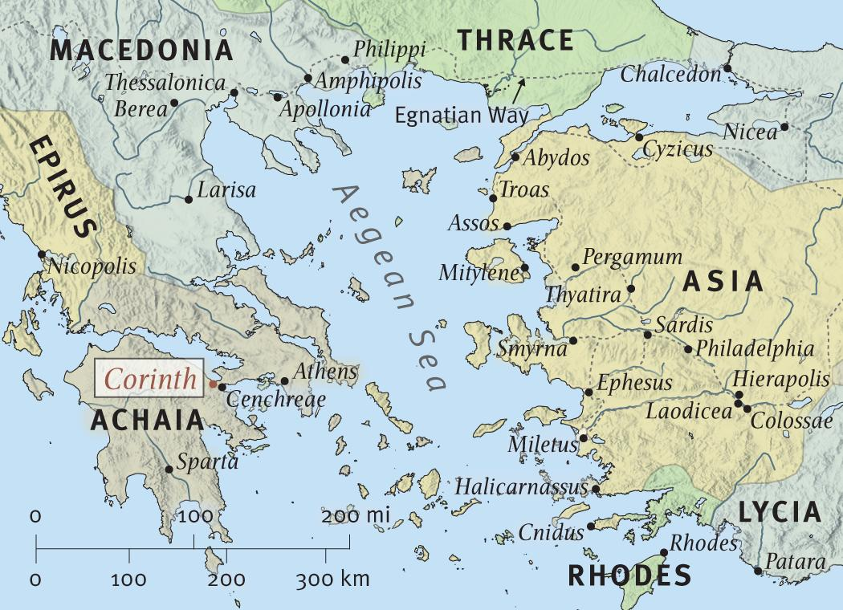
ANCIENT CORINTH IN THE FIRST CENTURY
* Source: ESV Study Bible Online (www.esvbible.org/)
* Source: ESV Study Bible Online (www.esvbible.org/)

Slide 6
INTRODUCTION TO 2 CORINTHIANS
1) Ancient City of Corinth in the First Century
It was the capital of the Roman colony, Achaia located close to the isthmus between Adriatic and Aegean Seas.
It was the center of commerce where international trades took place through the two harbors—on west (Lechaeum) and east (Cenchreae).
It was a cosmopolitan city, proud of its wealth, philosophy and culture; famous “Isthmian games” were held every other year.
It was the center of sensuality and immorality (temple of Aphrodite, the goddess of love and sex); to corinthianize [Gk. korinthiazomai] meant “to practice fornication.”

Slide 7
INTRODUCTION TO 2 CORINTHIANS
2) Historical Background of 2 Corinthians
Paul planted the Corinthian church during his second missionary journey while staying in Corinth for 18 months—from A.D. 50-51 (Acts 18:1-17).
Paul wrote this letter from Macedonia around A.D. 55/56 about a year after writing 1 Corinthians. He had just finished his 3-year ministry in Ephesus and went to Macedonia to visit churches and also to meet Titus, who had returned from Corinth with news about the church there (Acts 20:2-3).
Paul actually wrote four letters to the Corinthian church:
Letter A: ineffective in correcting the problems (now lost).
Letter B: 1 Corinthians → ineffective; prompted Paul’s “painful visit.”
Letter C: “severe letter” → effective (now lost).
Letter D: 2 Corinthians ← as a response to Titus’ report that his “severe letter” was received well by the church (change of hearts toward Paul).

Slide 8
INTRODUCTION TO 2 CORINTHIANS
3) Purpose and Structure of 2 Corinthians
Its purpose was to vindicate Paul’s apostolic ministry in three main ways:
To comfort/strengthen the faithful majority in Corinth (those who repented from their rejection of Paul due to the “severe letter”).
To urge them to contribute to the financial needs of the Jerusalem church, as an expression of their repentance.
To challenge the rebellious minority of the Corinthian church to repent before Paul returns to judge those still rejecting him and his message.
Its structure has three main parts.
Part 1: Paul’s defense of his ministry as an apostle of Christ (1:1–7:16)
Part 2: Paul’s urge to the repentant church for the collection (8:1–9:15)
Part 3: Paul’s appeal to the rebellious minority in Corinth (10:1–13:14)

Slide 9
COMPARISON OF FIRST AND SECOND CORINTHIANS
1 Corinthians | 2 Corinthians
Practical answers to the problems of the church. Warning against worldly wisdom and values. Instructional and theological. Reveals what an authentic church of Christ looks like. | Personal answers to the objections against Paul’s apostleship. Warning against “super apostles” and false gospel. Testimonial and biographical. Reveals what an authentic leader in Christ looks like.

Slide 10
INTRODUCTION TO 2 CORINTHIANS
3) Key Themes of 2 Corinthians
Strength in weakness: The central theme of 2 Corinthians is Paul’s biographical testimony about his suffering [weakness] and the Spirit’s work [strength] in his apostolic ministry. It is the essence of his apostolic authenticity of God’s paradoxical way to reveal his grace.
Reconciliation/Unity: Throughout this letter Corinthians Paul stresses the importance of reconciliation and relational unity among believers. Paul points this not only within their church but also with Paul himself. In Paul’s perspective, true unity doesn’t just happen—it requires constant vigilance, intentional work, and open hearts to one another.
True spiritual leadership: In this intensely personal letter, Paul opens up himself vulnerably to provide a real-life example of a true spiritual leader in Christ. It is a Christ-like, servant leadership which distinguish him from the false “super” apostles who look good on the outside.

Slide 11
WHY GOD ALLOWS AFFLICTIONS IN OUR LIVES
1) God allows it to strengthen us in our weakness as the Father of mercies and God of all comfort.
³ Blessed be the God and Father of our Lord Jesus Christ, the Father of mercies and God of all comfort, ⁴ who comforts us in all our affliction (vs. 3-4a)
Notice how many times the words, affliction and comfort in this beginning paragraph of praise in Paul’s letter. Why? It is a key theme of this letter.
The word, “comfort” [Gk. parakaleó] means much more than a few words of empathy—it means to strengthen, encourage as one walks alongside.
In other words, God strengthens us in such a way we can never experience unless we are under the real pressure of affliction/trouble.

Slide 12
WHY GOD ALLOWS AFFLICTIONS IN OUR LIVES
2) God allows it so that we can also comfort/strengthen others in affliction with the same comfort that we experienced from God.
. . . so that we may be able to comfort those who are in any affliction, with the comfort with which we ourselves are comforted by God. ⁵ For as we share abundantly in Christ's sufferings, so through Christ we share abundantly in comfort too. ⁶ If we are afflicted, it is for your comfort and salvation; and if we are comforted, it is for your comfort, which you experience when you patiently endure the same sufferings that we suffer. ⁷ Our hope for you is unshaken, for we know that as you share in our sufferings, you will also share in our comfort. (vs. 4b-7)
The natural result of receiving God’s comfort is to overflow to others.
In this sharing of God-given comfort, we experience true community life and mutual ministry and partnership in the gospel.
We are to welcome affliction TOGETHER with joy through faith in God!

Slide 13
Paul’s experience of suffering and comfort in the course of his ministry is replicated in every generation in the lives of godly missionaries and pastors in their interrelationships with their congregations. While both minister and people suffer as they bear witness to Christ in an alien culture, there remains a distinctive role and therefore a distinctive suffering to the Christian leader. As the comfort of God is experienced in the life of the leader, so it will be passed on through ministry to the people. Paul Barnett

Slide 14
THREE PRACTICAL QUESTIONS FOR OUR EVERYDAY LIFE
In what ways are you excited about this new series on 2 Corinthians? What encourages you most about the introduction to the letter?
What would it mean for you to bless the Father of mercies and God of all comfort, acknowledging that God’s will for you is good in affliction?
What is your first step toward comforting others with the comfort that you have received from God?

